Slide 1
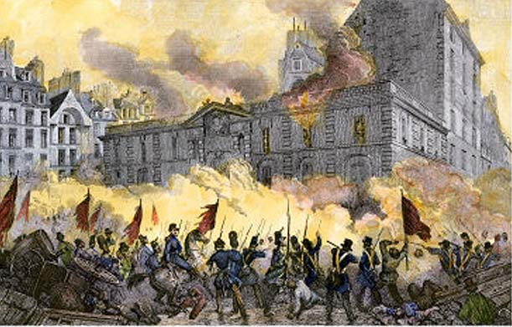
Age of Revolution

Slide 2
What is a revolution?
What is a revolution?
Are there any revolutions going on right now?
Where?
Share with the class

Slide 3
What is a revolution?
Revolution – a forcible overthrow of a government or social order in favor of a new system.
In other words…
When massive change occurs with a government or other part of society that results in a new way of doing something.

Slide 4
The 1700s
Remember where we have been…
Greeks, Romans, Middle Ages, Renaissance/Reformation, Enlightenment
The world is building up to another time of change - revolutionary change.

Slide 5
The Anatomy of a Revolution
Historian Crane Britton developed a blue print for the different stages of a revolution.
There are four main steps that the vast majorities of Revolutions follow:
American Revolution 1776
French Revolution 1789
Haitian Revolution 1791
Ideas of the Enlightenment thinkers were being applied in full force!

Slide 6
Stage One: Symptoms
There are certain economic restraints placed on the middle class by the government.
The government is also incredibly inefficient and is unable to manage the country (inept leader, money shortage)
The ruling party does not have the support of intellectuals.

Slide 7
Stage Two: Rising Fever
This is the escalation of anger felt by the middle class. This is when the people rise up.
This uprising culminates in a climactic battle and the current governmental structure collapses under financial debt and popular uprising.
The moderates form a new government, but are unable to weather the problems facing it.

Slide 8
Stage Three: Crisis
The revolution reaches a head when the moderates are violently removed from power by the radicals.
This is where the Reign of Terror begins as radicals set about to violently exterminate the opposition.
The Revolution also begins to lose steam with people growing tired and disillusioned.

Slide 9
Stage Four: Convalescence
The revolution is winding down and the nation enters a period of recovery.
A strong central leader comes to power and begins the process of stabilizing the country.
Most radical beliefs are abandoned

Slide 10
In the End
Most revolutions generally end up back where they started.
Some new ideas emerge, power structure shifts slightly, some reform is taken but overall there is still a ruling class that again tries to grab power.

