Slide 1
Appeasement

Slide 2
Hitler continues to expand
March 1936: Hitler takes the Rhineland
March 1938: Announces union with Austria

Slide 3
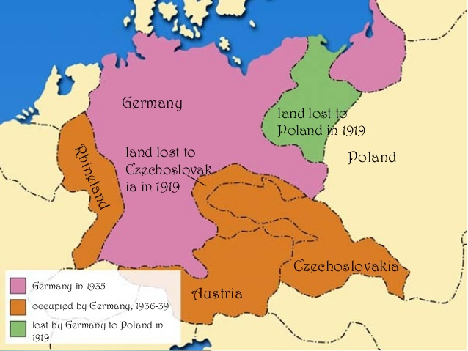

Slide 4
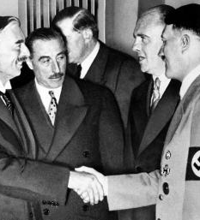
The Munich Conference
In September 1938 leaders from great Britain, France, Italy and Germany met in Munich.
Agreed that Hitler could taken Sudetenland as long as he stopped there.
Neville Chamberlin, the leader of Great Britain saw this as victory in avoiding a massive war with Hitler.

Slide 5
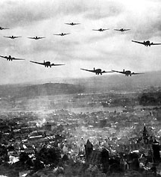
1939
Hitler invaded Czechoslovakia in March of 1939, breaking the Munich Pact.
Everyone knew Hitler’s next move was to Poland. In August of 1939 Britain signed a mutual defense treaty with Poland.
September 1, 1939 Hitler invades Poland. On September 3, 1939 Britain declared war on Germany.
https://www.youtube.com/watch?v=5Y9NexpibEo

Slide 6
Was appeasement the right policy? Or did it cause WWII to break out?

