Slide 1
The French Revolution
Part I

Slide 4
France at a Glance
Center of learning, science, society, trade.
Society was broken into Estates
1st Estate: The clergy
2nd Estate: The nobility
3rd Estate: Peasants/Bourgeoisie

Slide 6
What was happening in France
Financial Crisis
France was in MAJOR debt, but why?
They helped finance American Revolution
Majority of people were poor
King lived in opulent palace of Versailles.

Slide 7
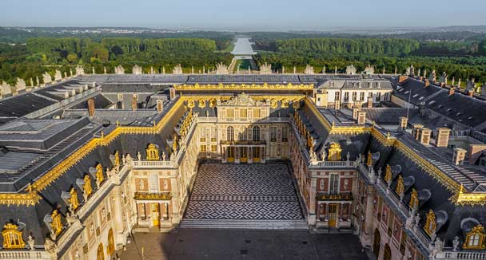
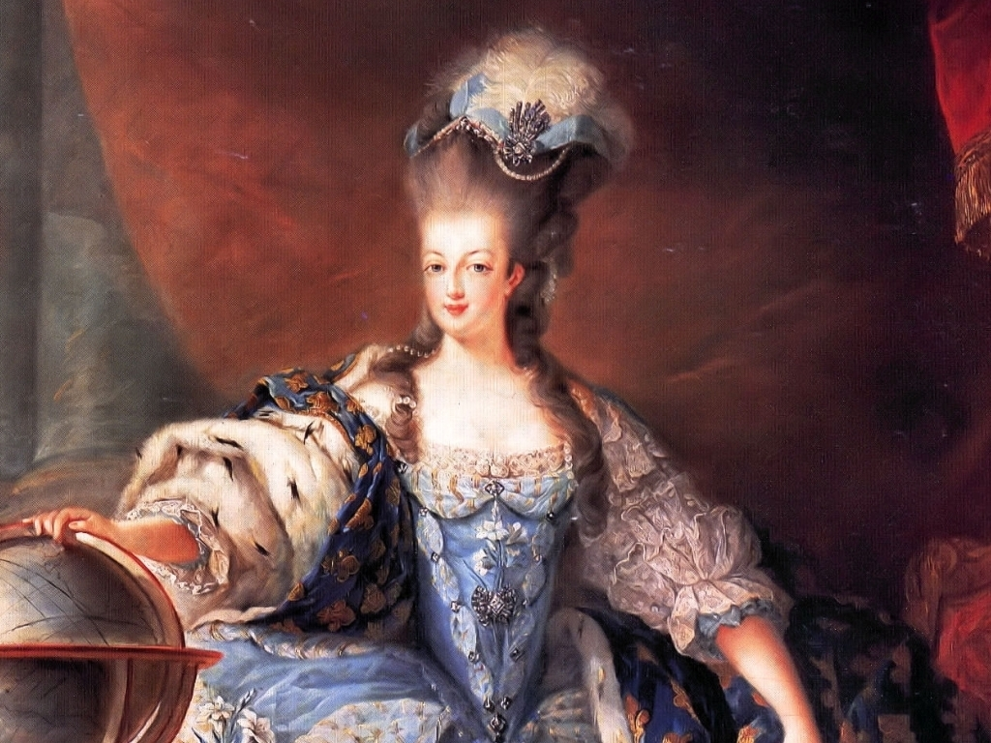
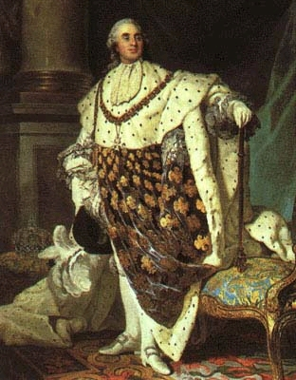

Slide 8
The Result
Sharp increase of taxes on the third estate
Poor wheat harvest caused an increase in price of flour and bread

Slide 9
Solutions
King Louis XVI was desperate because France was in debt.
He called a meeting of the Estates General.
All Estates meet, each gets one vote

Slide 10
National Assembly 1789
The King asked the people for help, but in the end, they revolt.
3rd Estate said they would conduct no business until the king was fair.
3rd changed their name to National Assembly on June 19.
Most of the 1st joined them.
Doors to the palace were then locked, so they went to the tennis courts.

Slide 11
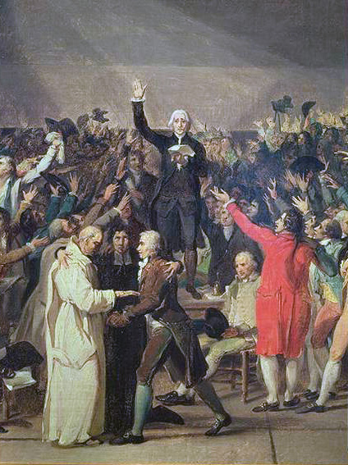
The Tennis Court Oath
Established a Constitutional Monarchy that would not disband until a constitution was created.
Took away all of church owned land.

Slide 12
Storming of the Bastille
July 14, 1789
25% unemployment in France
People were outraged, rushed a fortress (basically a prison) and captured it. It represented the corrupt king.
This was the beginning of the French Revolution and the fight for independence.

Slide 13
The March on Versailles
October 5, 1789
7,000 women stormed the palace of the Royal Family
They are captured and taken to Paris (Louis, and Marie Antoinette).
They royal family will never go back, prisoners.

