Slide 1
The M.A.I.N Causes of World War I

Slide 2
The War to End all Wars
Known as the Great War, not called WWI until after WWII.
Lasted from1914 to 1918
Total war involving over 60 countries.
Cost over 10 million dollars an hour.
New technology with old tactics.
But what caused it? There are four M.A.I.N causes

Slide 3
Militarism
Importance of building up military for war and giving them more power than the government.
Austria-Hungary, France, Germany, Great Britain, and Russia all began pouring money into the military.
New weapons and warships. Everyone was preparing for all out war.

Slide 4
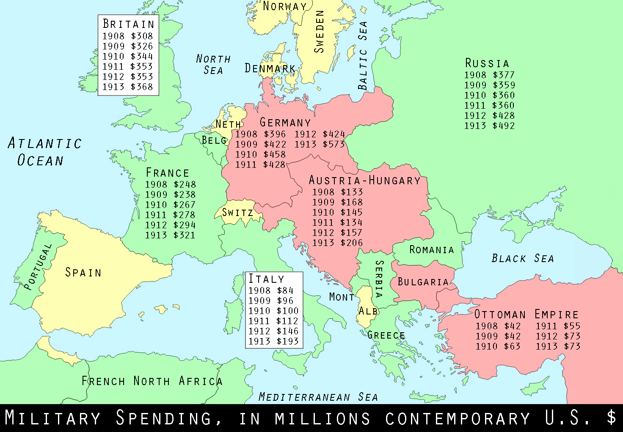

Slide 5
Alliances
European nations began to form a military alliances to maintain balance of power.
Remember, alliances give you more resources, power, soldiers etc.
Once one side did it, the other needed to as well. This continued to raise tension

Slide 6
The two sides of the war
The Triple Alliance (Central Powers)
Germany
Austria-Hungary
Italy (eventually)
Triple Entente (Allied Powers)
France
Great Britain
Russia

Slide 7
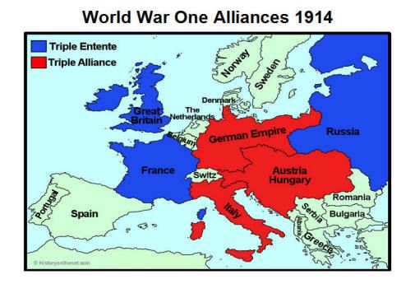

Slide 8
Imperialism
European powers were going to all parts of the world to gain land.
Africa, Asia, the Pacific
By 1910 the most desirable colonies had been taken.
Germany envied France and Britain because they had the richest colonies.
They soon realized the only way to get land in Africa was to take it.

Slide 9
Nationalism
1. Acting in the country's own national interest.
Alsace-Lorraine was a strip of land on the border of France and Germany.
Germany took it in 1817 and France expected to take it back.
Germany did not want to give it up.
PROBLEMS

Slide 10
Nationalism
2. Ultimate pride in ones country.
Most countries in Europe at this time saw themselves as superior to everyone else.
Were willing to fight to prove it.

Slide 11
All of these ideologies played into the war, but what sparked it?

Slide 12
Assassination of Franz Ferdinand

Slide 13
What happened
Archduke Franz Ferdinand was the heir to the Austria Hungarian throne.
Serbia was controlled by Austria Hungary and a nationalist group, known as the Black Hand wanted independence.

Slide 14
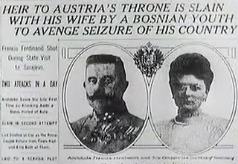
What happened
On June 28, 1914 Arch Duke Ferdinand and his wife were assassinated by Black Hand member Garvillo Princip.
Austria-Hungary (rightly) believed Serbia was behind the attack, and declared war on Serbia on July 28, 1914.

Slide 15
Chain Reaction
July 29, 1914: Russia who was allied with Serbia began mobilization.
Germany demanded they stop, which they didn’t. Germany declared war on Russia
Russia’s ally France declared war on Germany.
Germany declared war on Belgium.
Great Britain declared war on Germany

Slide 16
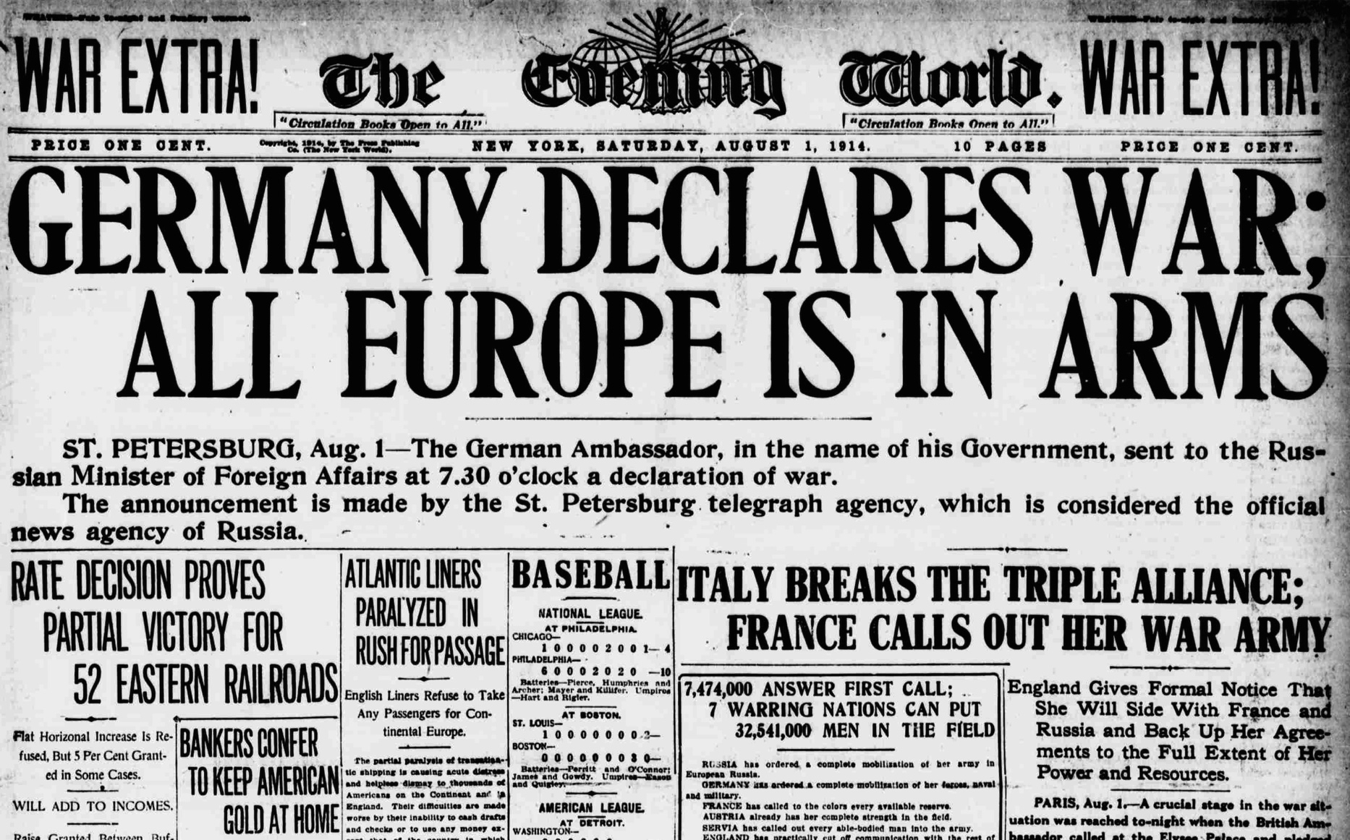

Slide 17
The war begins
Now the war has begun. In four years more than 16 million people will lie dead and Europe will be in shambles.
Was this war inevitable?

