Slide 1
Chapter 1: Colliding Worlds 1450-1600

Slide 2
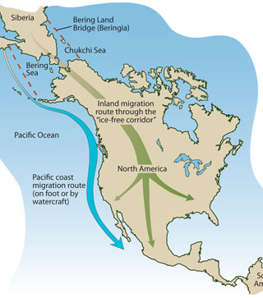
Early North America
The first Americans were thought to have migrated over the land bridge connecting Asia to Alaska around 13,000 B.C.E.
Most ended up migrating down to central and South America, but groups did develop throughout the continent.
Around 6000 B.C.E. people began to domesticate crops which encouraged growth and laid the foundations for mass empires.
The Incas and the Aztecs

Slide 3
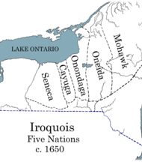
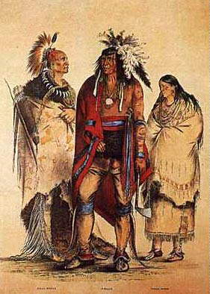
Native American Organization
Some North American tribes organized as chiefdoms: where one individual claimed preeminent power over a community (ex: Powhatan).
Others created Confederacies: power given to council of leaders (The Iroquois Confederacy)
This was a way to combine resources, gain power in numbers.
Social structure and organization depended on region: the Great Lakes people were mobile more social identity, the North west had powerful competing chiefdoms

Slide 4
Patterns of Trade
Expansive trade networks tied regions together and carried valuable goods like food, tools, ritual artifacts and luxury items.
This allowed tribes to communicate, trade resources, stabilized diets and enhance economies.
Typically leaders of chiefdoms and confederacies held the majority of the wealth and redistributed it to his people.

Slide 5
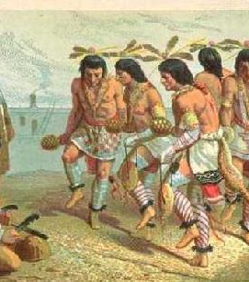
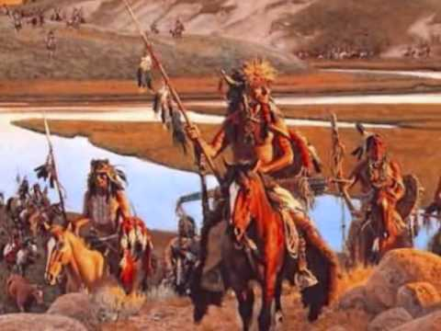
Sacred Power
Most Native Americans were animists who believed the natural world was fused with the spiritual world.
Women were often linked to powers of the earth and creation.
Men were often linked to powers of war and hunting.
Many rituals for hunting, use of the animal, war, and family heritage.

Slide 6
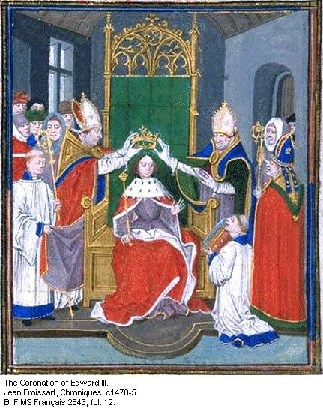
Western Europe: Authority and Hierarchy
In Europe kings owned vast lands and lived off peasantry’s labor.
Power was held by established institutions because it offered stability and security in a war filled continent.
The majority of the people were peasants who lived off king’s land. These people made up the majority of migrants to North America.

Slide 7
Expanding Trade Networks
In the 1100s Italians began to expand trade into the Arab world and eventually spread into all parts of Europe.
This created wealthy merchants, growth of banking and manufacturing, and spurred technological innovations.
Celebrated civic humanism: public virtue and service to the state.
SUPER influential in the new world.
Kings allowed trade from guilds (merchant groups) in exchange for taxes.

Slide 8
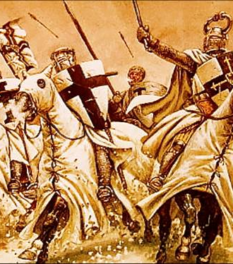
Religion
The rise of Christianity in Europe was a turning point for the continent and became a large unifying source.
The Crusades (1096-1291) was an attempt to push Muslims out of Europe and Arab world.
This introduced western European merchants to new trade routes into China
This was when Europe discovered sugar (becomes super popular and super important).

Slide 9
Exploration and Conquest
Portugal was the first to invest in exploration and navigation.
Eventually ports were set up along the African Coast establishing the beginnings of the lucrative and massive Atlantic Slave Trade.
Spain’s Ferdinand and Isabella were the first monarchs to heavily invest in exploration financing the journey of Christopher Columbus in 1492.
Landed in Bahamas and believed he made it to India
Eventually new world was named America after Amerigo Vespucci
Disease ravaged the new world and its natives who had never been exposed to European disease.

Slide 10
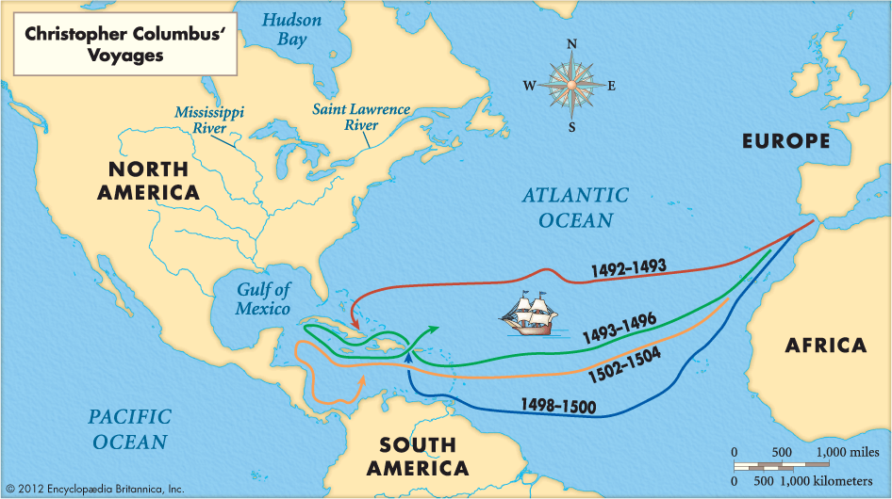

Slide 11
Legacies of Conquest
By the end of the 16th century European colonization had barely begun, but several of its most important elements were already taking shape:
The Spanish: learned that densely populated empires were especially vulnerable to conquest, and an incredible source of wealth.
The Portuguese: pioneered the Transatlantic Slave TRADE and discovered the viability of sugar in the new world.
Devastating vulnerabilities of disease.

