Slide 1
The Civil War: part 1

Slide 2
The beginning: fort Sumter
A resupply ship was sent to restock Fort Sumter, Jefferson Davis decided to seize the fort
On land owned by the united states but “in the confederacy”
Opened fired on April 12, 1861.
This was the official start to the civil war and Lincoln used this as justification. For military assault on the confederacy
http://www.pbs.org/kenburns/civil-war/watch-videos/

Slide 3
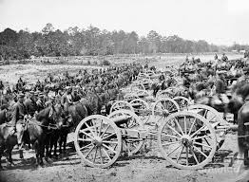
Mobilizing armies
Lincoln gradually organized an effective central government able to wage an all-out war.
The south had a difficult time because of states suspicious of centralized rules
In 1862 the Confederacy created the first legally binding draft
Required soldiers to serve duration of the war age 18-35
Exempted the planter and draftees could hire a substitute
In the North, the union was more ruthless towards draft resisters and Lincoln suspended habeas corpus and imprisoned 15,000 southern sympathizers without trial
Democrats used the draft to gain more support against Lincoln

Slide 4
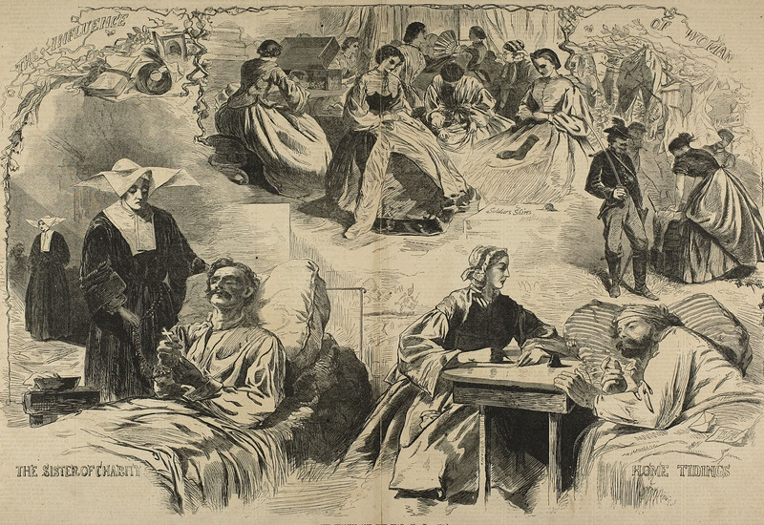
Mobilizing civilians
The union created the U.S. Sanitary Commission which provided food, clothing, housing, nurses and doctors to soldiers
Disease was still rampant killing 250,000 union soldiers over the course of the war
Health was even worse in the south because of their poorly designed health systems
War also drew more women into wage earning workforce as nurses, clerks, factory workers
Often said that women’s movement advanced 50 years in the four year civil war

Slide 5
Mobilizing resources
The union has a huge advantage in terms of resources
Two-thirds of nations population and railroads
90 percent of industrial output and equipped for mass production
The Confederacy relied on King Cotton for materials, wealth, resources
Republican instituted a neomercantilist program of government assisted economic development
High tariffs
Free land and Homestead Act of 1862
Nationally financed transportation system
New industries popped up as well: cattle, shoes, steel, coal, railroads

Slide 6
Financing the war
The North financed the war in three ways
Increased tariffs and taxes on on businesses
Interest paying bonds
Printing 150 million “greenbacks”
The South left most of the finance up to the states but did finance in some ways
30 percent from borrowing
60 percent from printing paper which caused massive inflation

Slide 7
The big battles
First and second Battles of Bull Run (1861): led by Stonewall Jackson were routes by the Confederacy.
showed that this war was going to be long, tough, bloody.
Antietam(1862): south moved into Maryland and McClellan ordered attack at Antietam Creek.
Union victory but bloodiest single day in U.S. military history
Vicksburg (1863): Grant takes Vicksburg and splits the Confederacy in two
First decisive victory of the union, and forced the Confederacy to attack up north
Gettysburg (1863): union victory that changed the tide of the war
http://www.pbs.org/kenburns/civil-war/watch-videos/

Slide 8
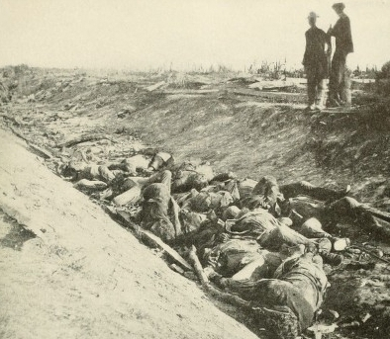
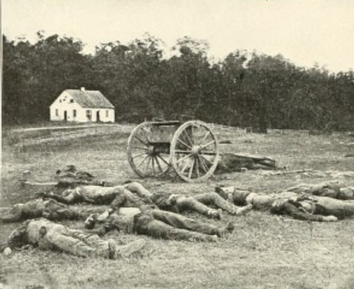
Antietam union: 12,400 casualties Confederacy: 10,300 casualities

Slide 9
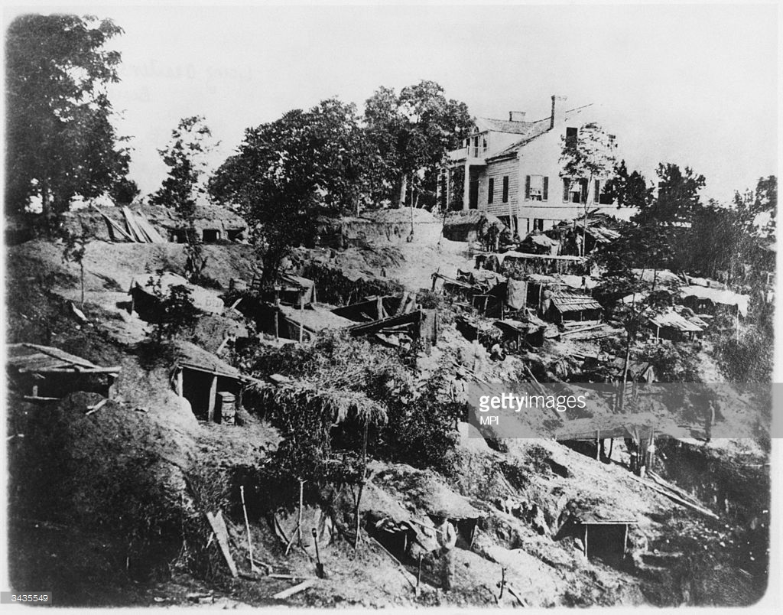
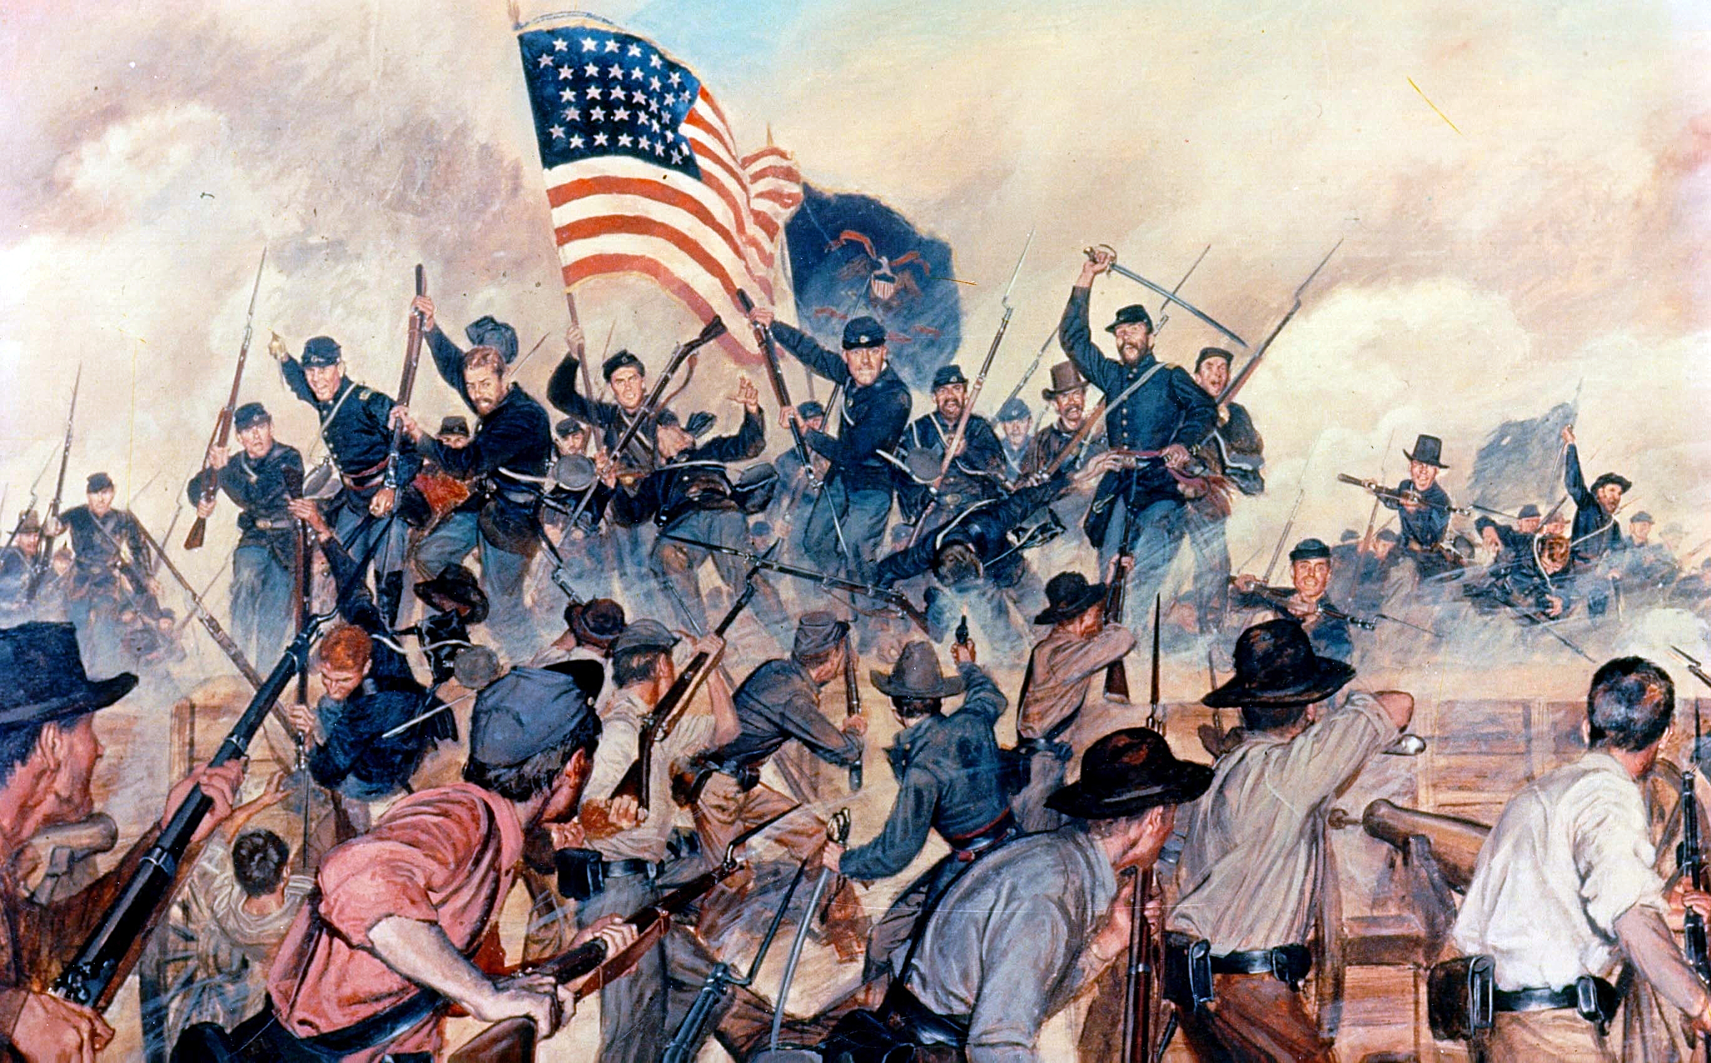
Vicksburg Union casualties:10,142 Confederacy Casualties: 19,091 aprx: 15,000 POWS

Slide 10
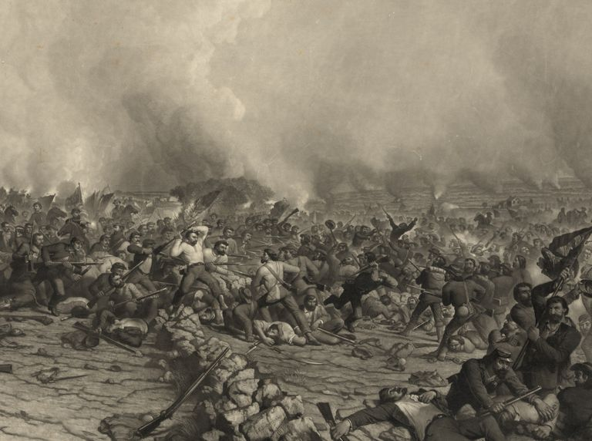
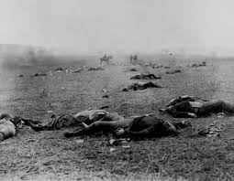
Gettysburg union casualties: 23,049 confederate casualites:28,063

Slide 11
Emancipation
Radical Republicans pushed for emancipation as an act of war
Slaves as war contraband and instrument to weaken the south
Lincoln saw the emancipation as a way to preserve the union
September 22, 1863 Emancipation Proclamation
Abolished slavery in all states that remained outside of the union
Did not initially free a single slave
Confederacy hated it, northerners unleashed racist backlash, and Democrats announced it as unconstitutional.
Lincoln did not back down and formally emancipated all slaves on January 1st.

