Slide 1
Civil war part 2

Slide 2
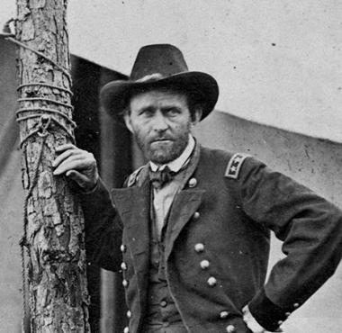
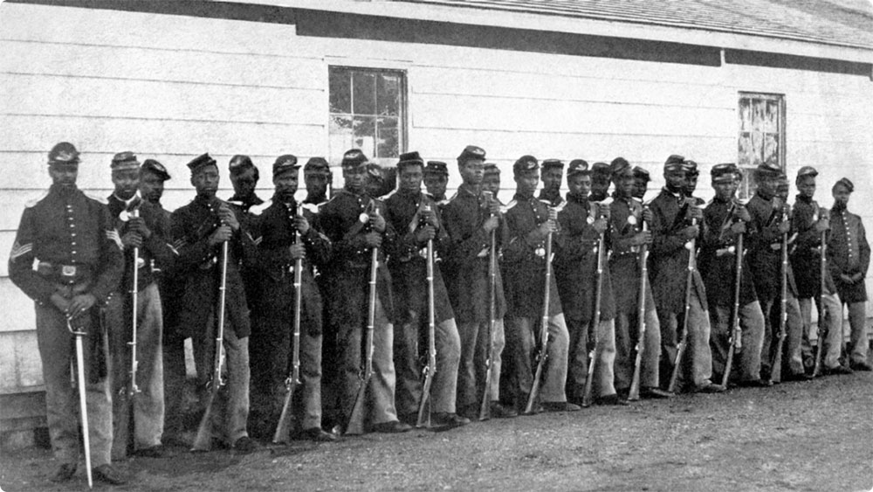
The North looks to end it
The enlistment of African American soldiers help swing numbers to the north's advantage.
In May of 1864 General Ulysses S. Grant ordered two major offensives
Set out to destroy Robert E. Lee’s force in Virginia (Grant)
Invade Georgia and take the city of Atlanta (William Tecumseh Sherman)
These were going to be aggressive, brutal, and forceful battles with the hope of finally crushing the Confederacy.

Slide 3
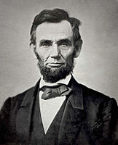
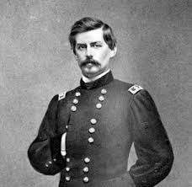
The Election of 1864
The Republicans: Abraham Lincoln
Supported Lincoln and his war strategy to create a confederate surrender and push for an anti-slavery constitutional amendment.
The Democrats: George B. McClellan
War Democrats: vowed to continue fighting until the rebellion ended
Peace Democrats: called for a convention to negotiate peace

Slide 4
Atlanta Falls
September 2, 1864 after a long campaign Sherman eventually gained position and the confederacy abandoned the city.
Sherman then drove south
Sherman’s March to the Sea
This was a demonstration of union power and took on a scorched earth policy.
“War is cruelty. There is no use trying to reform it. The crueler it is, the sooner it will be over”
“I will show no symptoms of tiring until the south begs for mercy”
The fall of Atlanta helped Abraham Lincoln win office in 1864 with running mate Andrew Johnson (Democrat)

Slide 5
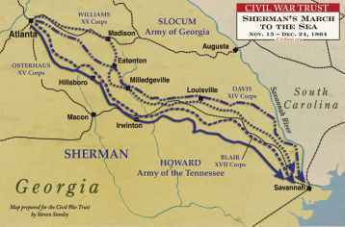
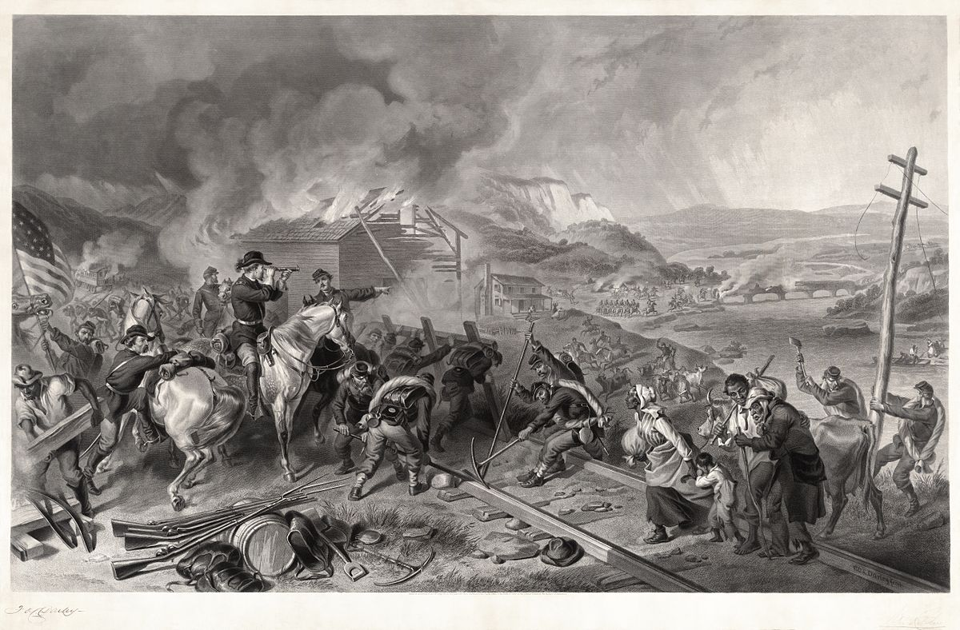
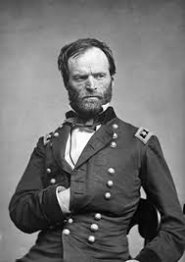
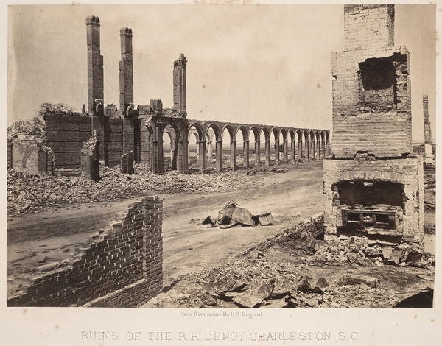

Slide 6
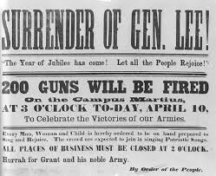
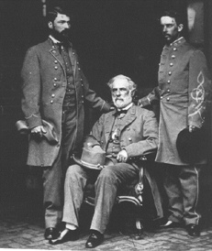
The End of the War
With Sherman’s march and Grant’s war of attrition in Virginia the confederacy was exposed
Rising class resentment
Angered by slave owner’s exemptions
In April of 1865 Grant took Richmond and cut off an escape route to North Carolina
April 9, 1865 Lee surrendered at Appomattox Court House in Virginia
260,000 Confederate soldiers dead
360,000 Union soldiers dead

Slide 7
Now what?

