Slide 1
The Final Solution
Hitler’s attempt to wipe out an entire people.

Slide 2
“The road to Auschwitz was built by hate, but paved with indifference”
What does this quote mean?
What do you know about the Holocaust?
What do you want to know about the Holocaust?

Slide 3
The Holocaust
The systematic and state sponsored persecution and murder of approximately six million Jews by the Nazi regime.
Targeted other groups for perceived “racial inferiority” including Roma (gypsies), the disabled, Poles, Russians, and homosexuals.
But why and how did this happen?
Not such an easy answer, more a question of human nature.

Slide 4
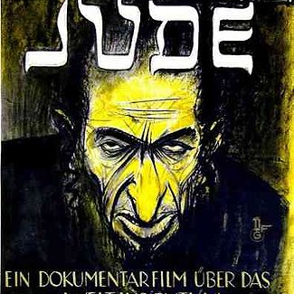
Why did this happen?
Hitler (and the Nazi party as a whole) believed the Jews were to blame for German down fall after WWI.
Jewish community was generally wealthy and affluent (doctors, lawyers, merchants) who were not as devastated by the Treaty of Versailles and the Depression as others.
Racial superiority: Believed in the pure Aryan race.
This is a difficult thing to understand/justify.
Historical basis

Slide 5
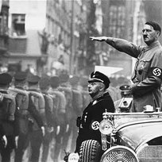
Why did this happen?
Also a question of man’s desire/need to blame. Germany suffered greatly in WWI and the Treaty of Versailles, Hitler used the Jewish community as a target to blame all the nation’s troubles on.
People like to have a central figure/group/object to blame struggles on- Hitler acted on this desire.

Slide 6
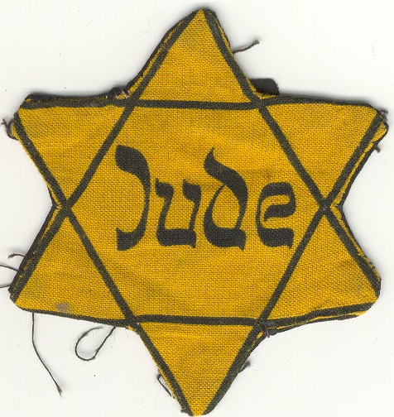
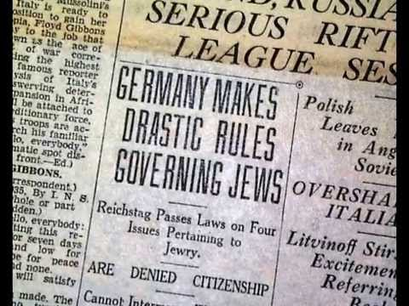
How did this happen?
This was NOT an inevitable act, it was a long deliberate and carefully executed mass genocide.
The Nuremberg Laws 1935: took away Jewish rights in Germany
Enforced curfews
Had to wear the yellow star
Zoning areas for housing
Prohibitive employment
Marriage restrictions

Slide 7
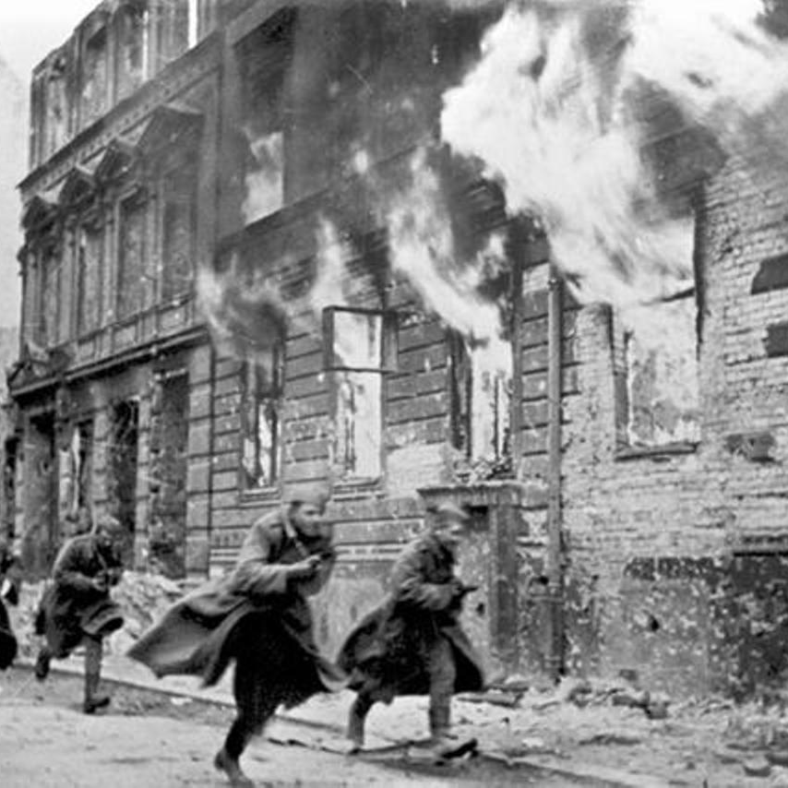
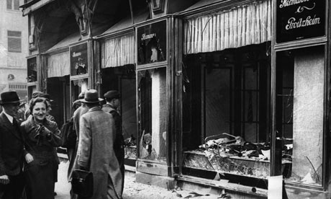
How did this happen?
November 9, 1938 “Kristallnacht” or The Night of Broken Glass.
Organized destruction of Jewish homes and businesses in Munich after a German officials assassination
Thousands of homes and businesses destroyed, with Jews forced to pay the damages.
https://www.youtube.com/watch?v=HrombDUtOYY

Slide 8
Eventually Jews were rounded up into caged ghettos in cities and eventually transported to labor and death camps.
But how did Hitler manage to convince his own secret police to carry out these acts? What was the justification?

