Slide 1
Intro to the Renaissance

Slide 2
Where we’ve been
After the fall of Rome, society was in a chaotic period of transition (the Dark Ages).
Power was everything, and kings as well as the Church looked to take as much as they could.
Around 1000 C.E. things start to change.

Slide 3
Changes in Society
Kings began to centralize their power and control bigger pieces of land.
Trade picked up and new routes were formed.
Banking systems were started.
Learning became a priority again, reading and writing began to become common for all people.

Slide 4
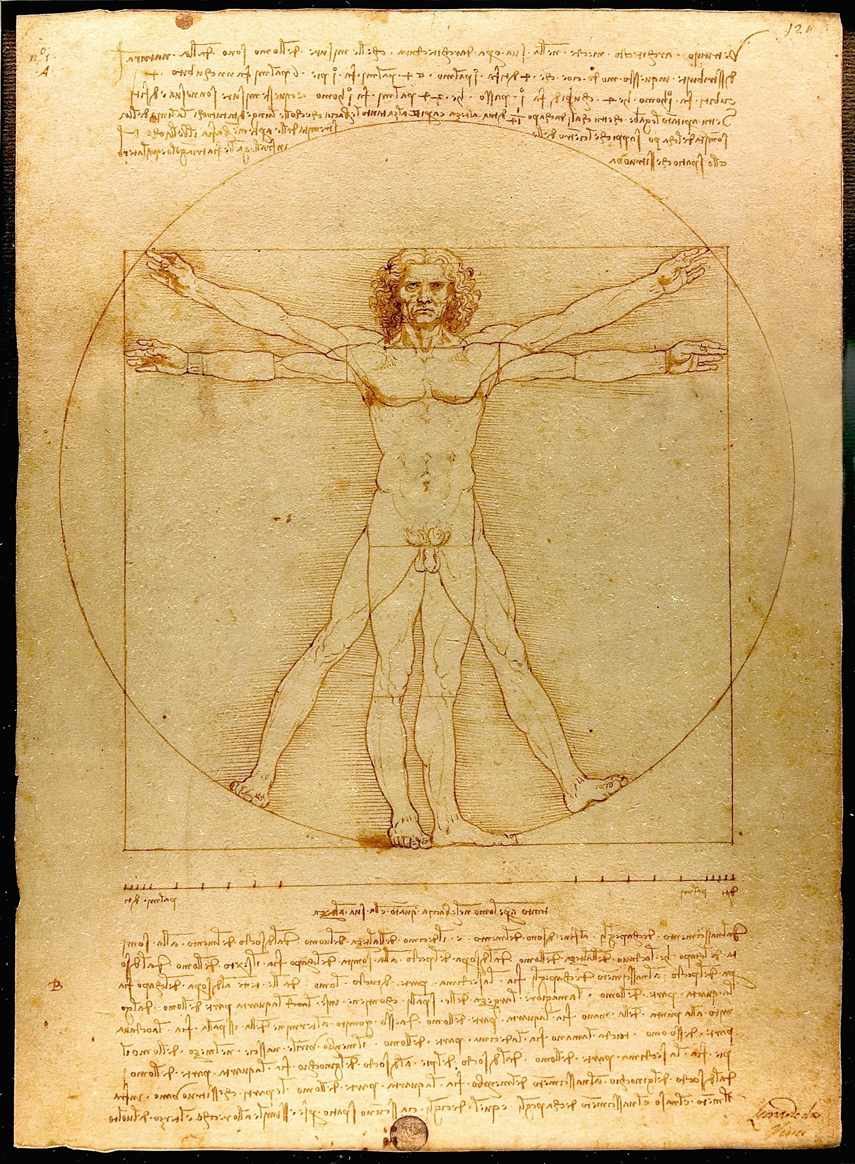
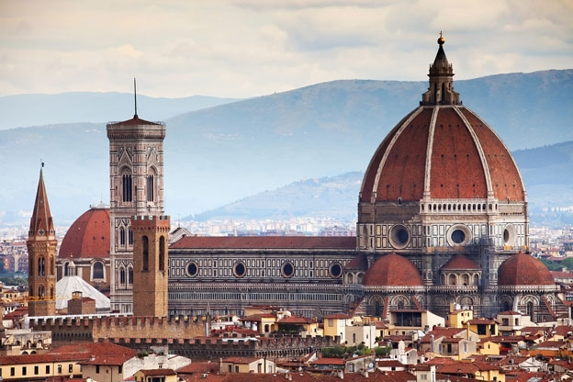
The Renaissance
Renaissance means “rebirth”
This was literally the rebirth of society.
Brought back classic, Greco-Roman culture. They wanted to recreate the power and glory of Rome
People began to create new developments in art, science, literature, mathematics.

Slide 5
Italian Beginnings
The Renaissance began in Italy in the 1300s. It eventually spread and reached the peak in 1500s.
Why Italy?
Italy was the center of old Roman glory
Italy’s cities survived the Middle Ages
Wealthy merchants encouraged the arts
Florence became the cultural hub of Renaissance Europe.

