Slide 1
Manifest Destiny

Slide 2
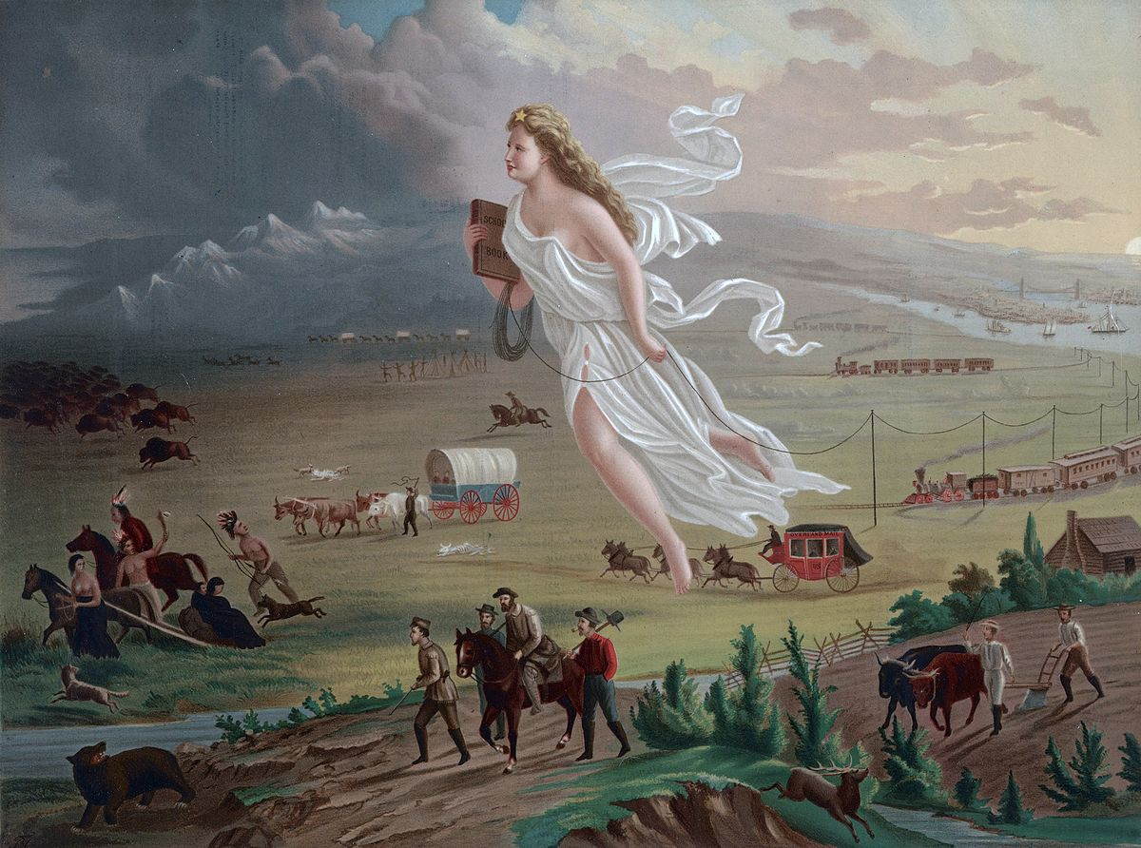

Slide 3
How it started
In the 1840s many citizens embraced the ideology of expansion and proclaimed a “god given duty” to extend republicanism to the Pacific.
“Other nations have tried to check the fulfillment of our manifest destiny to overspread the continent allotted by Providence for the development of our yearly multiplying millions” John L. O’Sullivan.
Rapid movement in the Oregon Territory as well as California, which was owned by Mexico.

Slide 4
Texas, 1845

Slide 5
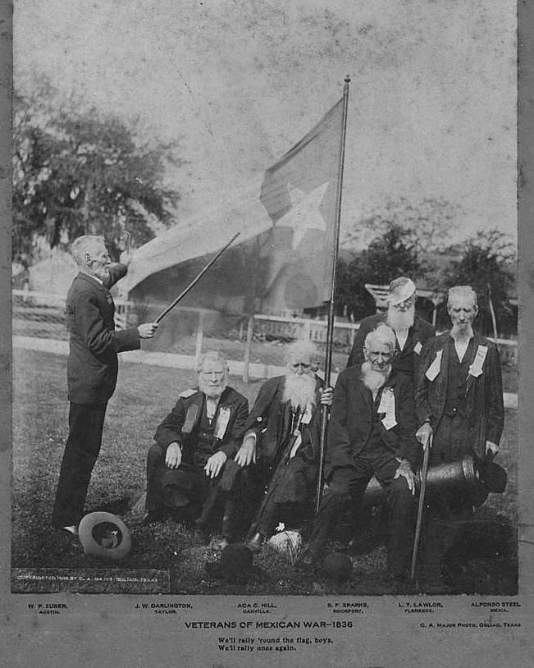
How it was Added
Stephen F. Austin’s Missourians colonized Texas.
Texas War for Independence (1836-1837)
Increased push for annexation into the United States and unique culture separate from Mexico.

Slide 6
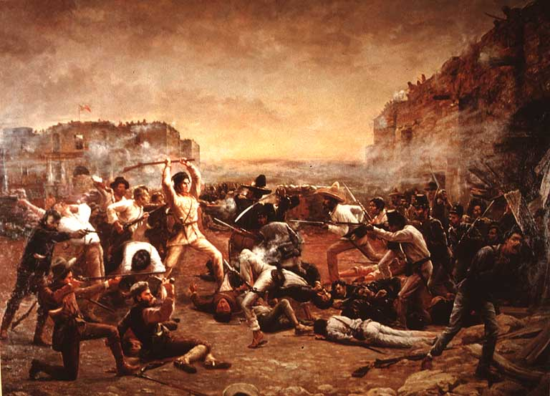
Nationalism
“Remember the Alamo”
James K. Polk the Manifest Destiny President demanded annexation.
Helped win Polk’s election and create the nationalist rhetoric

Slide 7
Sectionalism
Annexation means what in regards to slavery?
North v. South
South wanted Texas admitted as a slave state
Polk changed the policy that required 2/3rd votes for annexation to ½
Annexed as a slave state

Slide 8
Mexican Cession 1848

Slide 9
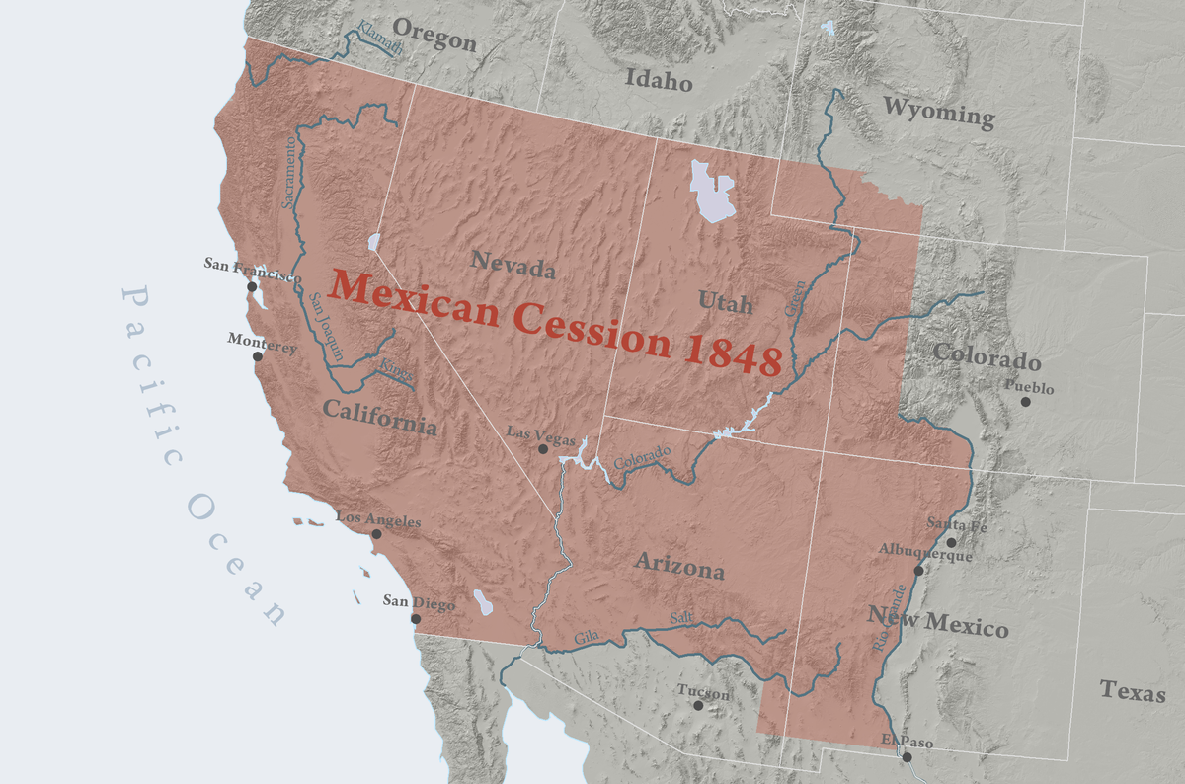
How it was Added
Mexican War (1846-1848)
The United States fights war to continue expansion into Mexico and California.
The U.S. wins despite the attempts of Santa Anna to rally Mexican troops
Treaty of Guadalupe Hidalgo
Mexico surrenders 2/5 of its land

Slide 10
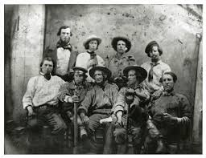
Nationalism
Manifest Destiny accomplished: “from sea to shining sea”, explosion of patriotism.
1849: California Gold Rush and the 49ers brought huge profit into the states, eventually leading to the wheat rush
Expanded trade with Asia

Slide 11
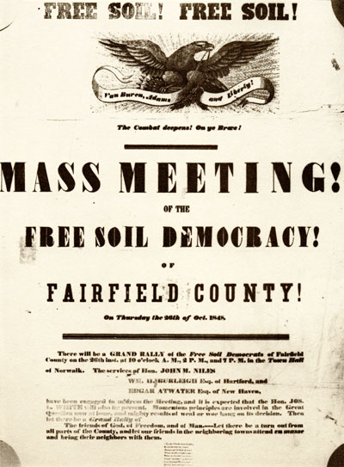
Sectionalism
The Wilmot Proviso: slavery should not be allowed in any territory won in the war
Free-Soil Movement: slavery threatened the general and equal distribution of land
Squatter Sovereignty: Congress would allow settlers in each territory to determine its status as free or slave

Slide 12
Sectionalism Continued
The Compromise of 1850
Support of fugitive slave act (no trial by jury)
Admitted California as a free state
New Mexico and Arizona popular sovereignty
Washington D.C. abolished the slave trade

Slide 13
The norther and Free Soil Party in the west demanded freedom of fugitive slaves and refused to accept the legitimacy of the compromise.
Southerners plotted to extend slavery west and central America

Slide 14
Did fulfilling our “Manifest Destiny” strengthen American Nationalism or divide the country along sectional lines?

