Slide 1
Military in WWI

Slide 2
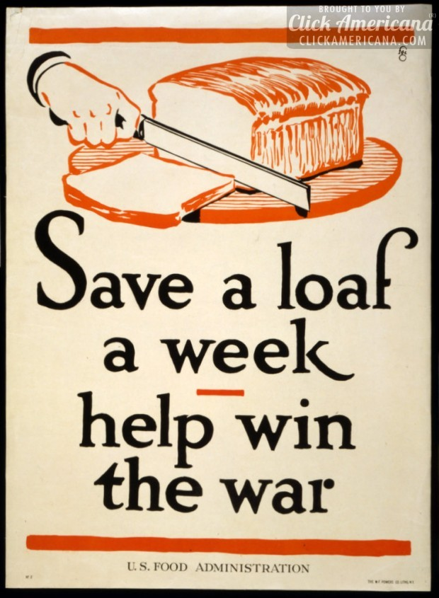
Winning the War
Countries realized that all resources needed to go to war effort.
Set up a draft, raised taxes, borrowed lots of money, rationed food, boots, gasoline, set prices, forbid strikes.
This was about controlling public opinion

Slide 3
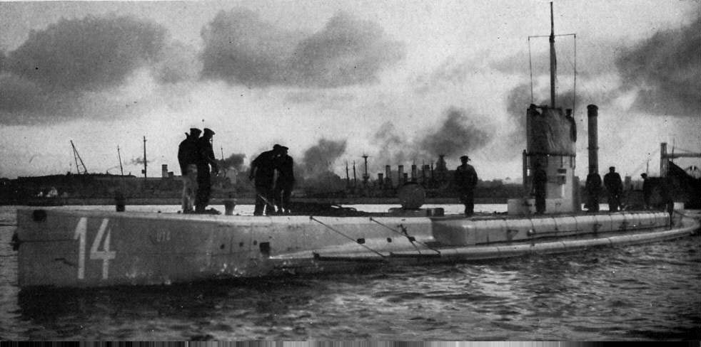
War goes to the Sea
1915: Britain blockaded all German goods on the Black Sea.
Germany declared it would sink all ships carrying goods to Great Britain.
Germany used submarines (called U-Boats) that were devastating.

Slide 4
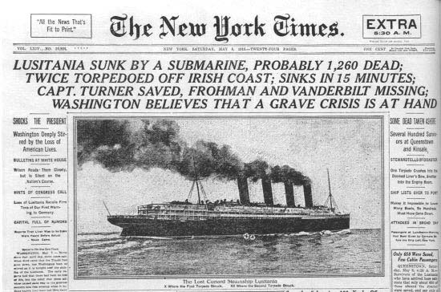
The United States gets Involved
The United States had been sending reinforcements and supplies to Britain and the Allies for a few years.
In May of 1915, the German’s sunk British liner The Lusitania, which killed 128 Americans.
This outraged many Americans, but they did not declare war until April of 1917

Slide 5
Tide of the War Turns
The American’s sent 2 million soldiers to Europe in 1918.
Large boost in morale, as well as financial aid.
Now the Allies looked for a final push to end the war.

Slide 6
Battle of Amiens
The Allies launched an attack in August of 1918 with a force of 75,000 men, 500 tanks, and nearly 2,000 planes.
On the first day the Allies gained 8 miles and caused 27,000 causalities.
Eventually the Germans were forced back through France and Belgium.

Slide 7
The End of the War
In early November the Kaiser (leader) of Germany stepped down and a new government sought an armistice.
The war came to an end on November 11, 1918.
“On the eleventh day of the eleventh month on the eleventh hour.”

Slide 8
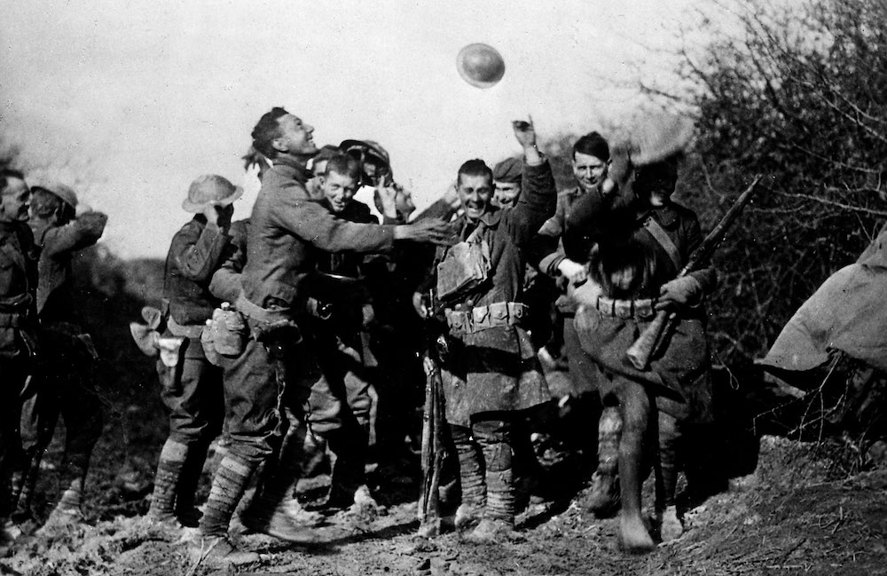
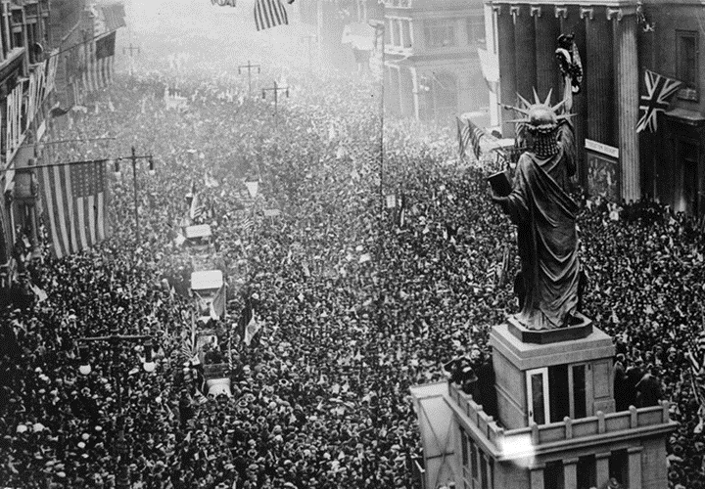
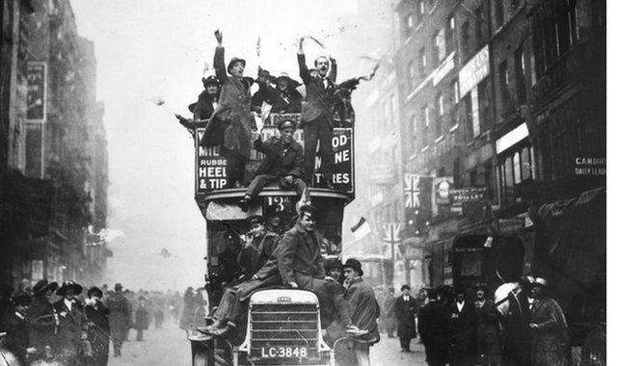

Slide 9
Now what?
16 million causalities, made worse by the influenza epidemic that killed 20 million world wide.
All over Europe whole cities were destroyed. The governments of Germany, Russia, and Austria-Hungary’s government collapsed
People on both sides were very bitter towards each other.
The Allies blamed the Central Powers and demanded reparations.
The Allies needed to meet to decide what the fate of Europe would be.

