Slide 1
Period 3 Review

Slide 2
The Colonies Transform
After the Seven Years War, Great Britain was in major debt and looked to colonies for revenue.
Decided to raise taxes with a series of acts
Revenue Act of 1762: collection of trade duties
Currency Act: banned independent colonial currency
Sugar Act of 1764: replaced Molasses Act and lowered duty on sugar but it was heavily enforced
Stamp Act 1765: tax on all printed items
Quartering Act of 1765: forced lodging of British troops
After years of Salutary Neglect, colonists wanted representation and a say in taxes

Slide 3
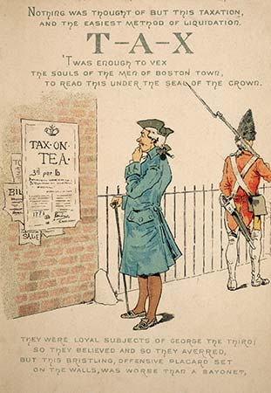
The Dynamics of Rebellion
Three intellectual roots of the colonial resistance
One: English common law which protected the lives and property of people from the king
Two: The Enlightenment
Three: Whig republican tradition
British respond with the Townshend Acts
Parliamentary debate started with the Stamp Act, military action plan began with the Townshend Acts.

Slide 4
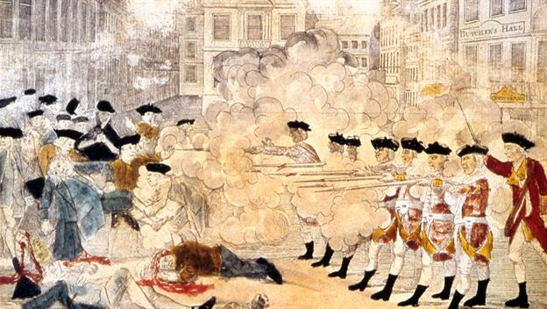
Tensions Rise
Lord North repealed the Townshend Act after merchant discontent
Did retain a tax on tea as a sign of parliamentary supremacy
March 5, 1770 five Bostonians were killed by redcoats- The Boston Massacre
Reaction was mixed
Most remained loyalty but it was starting to take its toll
Some radicals wanted independence

Slide 5
Political Unrest Rises
The Tea Act of May 1773 provided relief for the East India Company and radicals accused British of bribing Americans to buy cheaper tea.
The Boston Tea Party
King George was outraged and passed the Coercive Acts in 1774, this was essentially a death sentence for Boston.
Colonists call a Continental Congress in 1774 to respond
Demanded a repeal to the coercive acts
Threated to stop importing British goods if acts were not repealed.
Many were concerned because they owned money to British, others thought this was an attempt at self interest

Slide 6
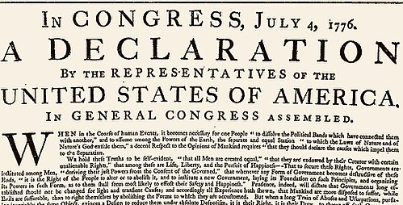
Organizing for War
In 1774 Thomas Gage ordered troops to seize Charlestown and Cambridge
Paul Revere and the Minutemen
In may 1775, the Second Continental Congress
Still torn about what to do but cut off British goods
Thomas Paine’s Common Sense
The Olive Branch Petition
On July 4, 1776 Congress approved the Declaration of Independence

Slide 7
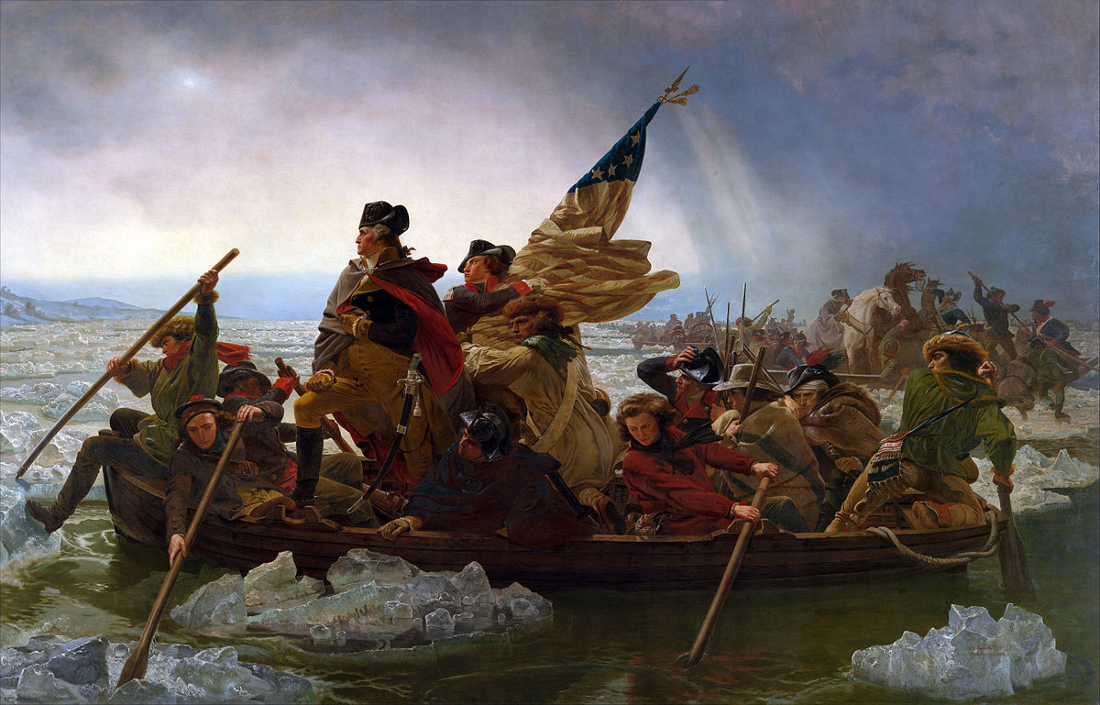
The Revolution Begins
British plan to isolate colonists in New England by taking New York.
George Washington’s crossing of the Delaware
Washington’s goal was to draw Britain away from the coast and extend supply lines
The Battle of Saratoga
The colonists first victory that brought France into the war on the colonists. side

Slide 8
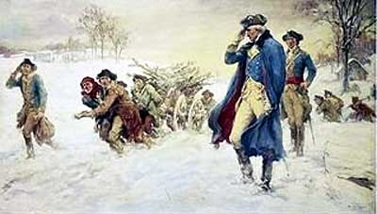
Financial and Morale Crisis
Most colonies were afraid to raise taxes so they purchased bonds from wealthy merchants, and printed money
Morale crumbled under fear of the revolution falling apart
Valley Forge 1777
Winter of 1777 colonists suffered horribly in camp: starvation, disease, fatigue

Slide 9
The Path to Victory
The Treaty of Alliance of February 1778 changed the tide of the war
Formal alliance with France
France would recognize U.S. independence and France would recognize conquests in the West Indies
With formal military backing from France, Washington devised a daring plan and ended up isolating General Cornwallis at Yorktown and ultimately forced a surrender
Isolated diplomatically
Cut off from supply lines
Lacking public support
Signed the Treaty of Paris in 1783
Formally recognized independence but could pursue legal claims of prewar debts

Slide 10
Now what?
Colonists liked the idea of popular sovereignty but did not want extreme democracy
Lots of different groups had different thoughts
Had to address loyalists
What to do with the west? Poor farmers? Native America?
The Articles of Confederation
Loose alliance of states
No chief executive, no power to tax, no uniform currency
Almost immediately realized they had no way to pay back war debt , also had to deal with the west and Shay’s Rebellion
The Ordinances between 1784 and 1787 set the basis of western expansion in the future
Reaction to taxes on farmers

Slide 11
The Constitution of 1787
In May 1787 delegates met in Philadelphia to figure out how to address colonial issues. Eventually decide to throw out the Article and write a constitution
The Virginia Plan: one house congress where representation was based on population.
The New Jersey Plan: one house congress where representation was equal.
The Great Compromise: two house congress with one house based on population, and one with equal per state.
The Slavery conflict: decided to count each slave as 3/5ths of a person
Created a powerful national government with a legislative, executive, and judicial branch, also put the federal government in charge of taxes and paying back debts
Created the debate between the Federalists and the Anti-Federalists

Slide 12
Financing the Republic
Alexander Hamilton (Federalist) outlined a system of nationally assisted economic development.
Pay back war securities
Assuming war debts from the states
Create the National Bank
Expand manufacturing
Thomas Jefferson (Anti-Federalist) wanted a country led by small independent farms and a small federal government
Hamilton won and the United States enjoyed a period of increased trade, increased customs revenue, and the national debt decreased.

Slide 13
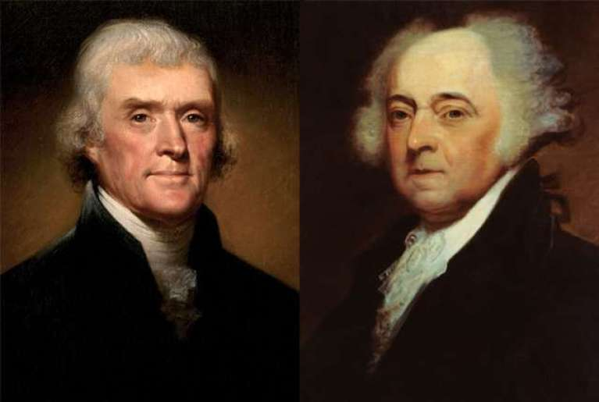
The First Party System
The Federalists and the Republicans
Merchants in the north supported Federalists, southern planters supported Republicans
Federalists won under John Adams and set forth an aggressive policy of limiting individual rights (The Alien and Sedition Acts)
In 1800 Jefferson won, known as the Revolution of 1800, first peaceful transfer of power between political parties

Slide 14
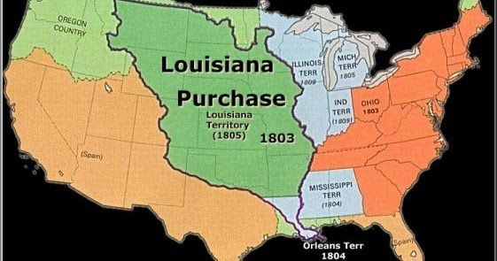
Jefferson Presidency
Waves of migration out west forced the issue of dealing with Native Americans.
Jefferson pursued policies that made acquiring land easier
The Louisiana Purchase
Purchased land from France that almost doubled the size of the country
Sent Louis and Clark west for mapping and research

Slide 15
The War of 1812
The conflict between Great Britain and France led to Britain seizing American ships
The Embargo of 1807
Prohibited American ships from leaving ports until Britain and France stooped restricting trade
Didn’t work, American merchants protested and Britain was able to survive without American goods.
Soon after the war began, Great Britain began to take control, fortunately both sides wanted peace: Treaty of Ghent formally ended the war putting everything back to the way it was.
The rise of Andrew Jackson and the Battle of New Orleans

Slide 16
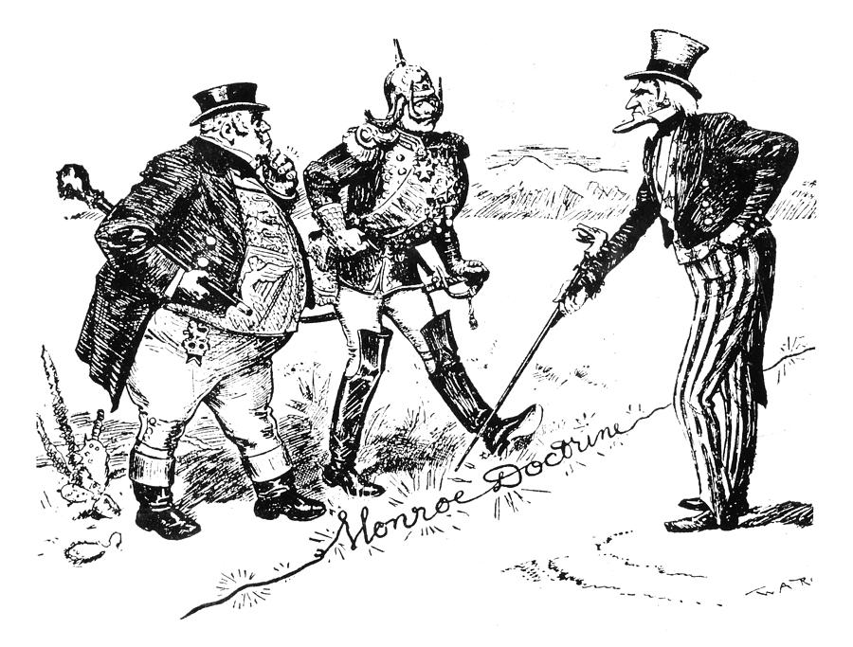
The Federalist Legacy
The War of 1812 split the Republican party into two camps and the Federalists were adopted by new Whig party. States rights advocated were Democrats
The Monroe Doctrine asserted America’s power in the Western Hemisphere and declared America’s intent to stay out of European conflicts.

Slide 17
The Capitalist Commonwealth
Advocated for neomercantilism: government assisted economic growth
The Panic of 1819 began because of shady bank dealings, world agricultural prices dropping and farmers being unable to pay back debt.
First taste of capitalist system of periodic booms and busts
State financed infrastructure development also helped expand American markets
New shift of cultural success based on achievement not family status.

Slide 18
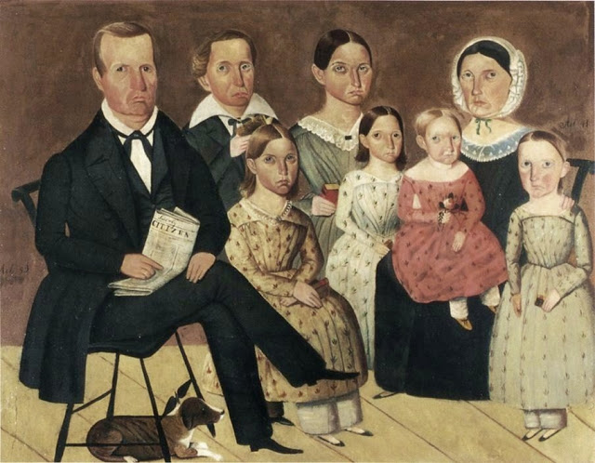
The Republican Family
Rise of sentimentalism: men and women began to marry because of mutual love, rather than family inheritance.
number of children per family dropped, education became a priority, women took an active role in household affairs

Slide 19
The Question of Slavery
The question of slavery was a conflict because it directly opposed American ideals.
The south advocated that republicanism only applied to whites and that slavery was an economic system
Missouri wanted to become a state, but the question was whether it should be admitted as a free state or a slave state.
Missouri Compromise: admitted Maine in as a free state, and Missouri in as a slave state.
All other state entries must be entered to keep state count balanced.

Slide 20
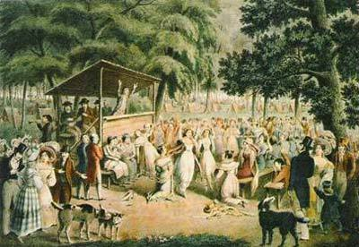
America as a Christian nation
The Second Great Awakening was a period of religious revival in the United States.
Boom of Baptist and Methodist churches
Women began to play an active role in churches as well as become teachers
First entry into public life
Capitalism, republicanism, and Christianity became the core of the new American identity.

