Slide 1
The philosophes
Taking ideas and making them reality… finally

Slide 2
The philosophes
These Enlightenment thinkers were primarily from Britain and France primarily in the 18th century.
They were public figures who created many ideas about the nature of man, the roles of government, and conduct of society.
They were unhappy with current systems of government and treatment of individuals and believed changed needed to take place. These men sparked men revolutions we will discuss later.
These were the first thinkers to attempt to make ideas into legitimate change. You see many of their ideas present in society today.

Slide 3
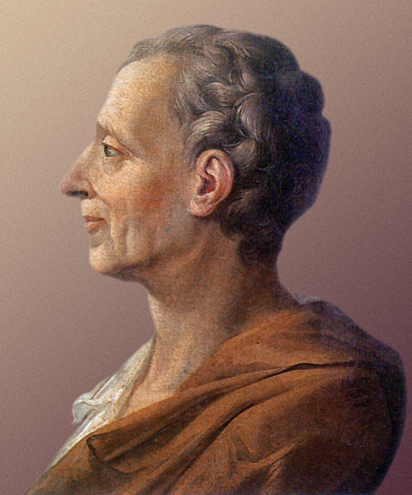
Baron de Montesquieu
Born in France in 1689. He became a lawyer and famous writer who criticized the French king and Catholic Church.
Believed government should be broken into different section and each had the power to control the others. He believed this would prevent one ruler from becoming too powerful.
Wanted three branches: one to create the laws, one to enforce the laws, one to interpret laws.

Slide 4
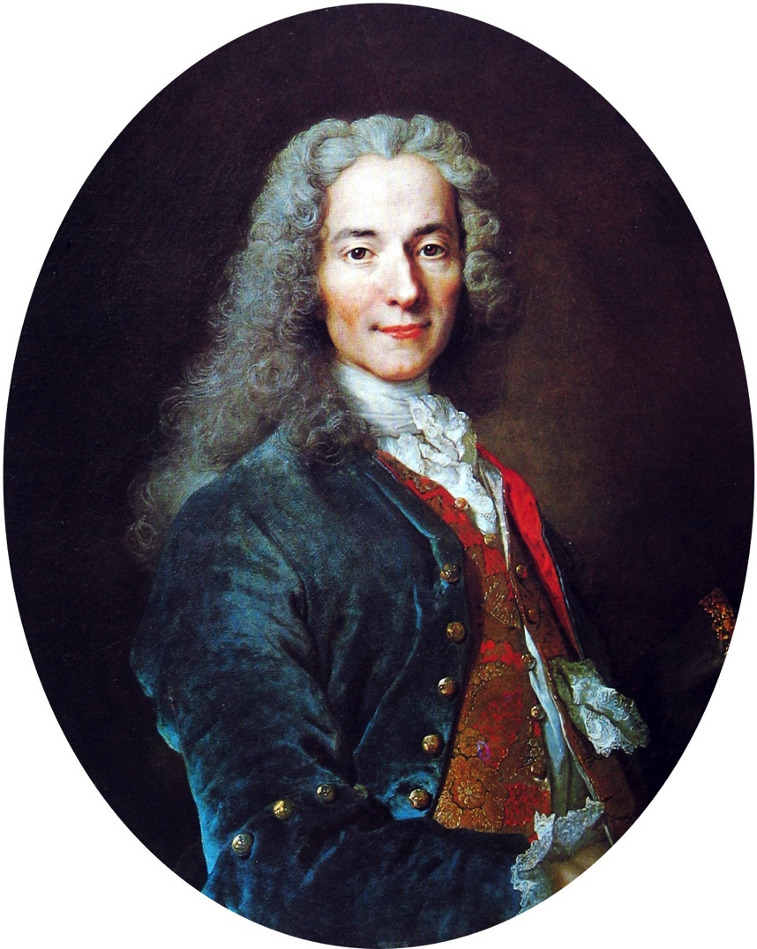
Voltaire
Born in France, was put in prison twice for critiquing French government and eventually moved to England.
Believed in freedom of thought and the importance of reason and logic.
Believed religion was too powerful and felt it had no place in government. Did not believe people should be prosecuted because of religious beliefs.

Slide 5
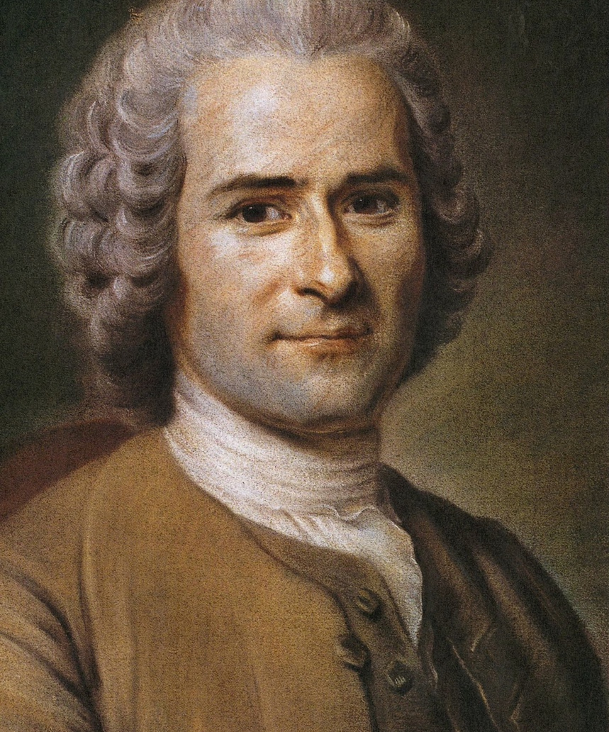
Jean-Jacques Rousseau
Born in Switzerland and eventually moved to Paris and became a music teacher.
Believed whatever the majority of people wanted should become law, he was against absolute power.
Believed individual rights should be strictly enforced and protected by the government.

Slide 6
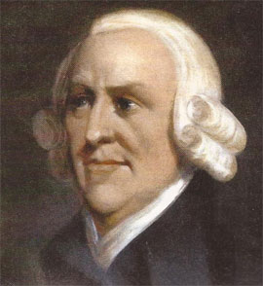
Adam smith
Born in Scotland and left for school in Britain at age 14.
First thinker to focus on economics and its role in society.
Believed that someone working to earn money benefited himself but also benefited society.
Often called the founder of modern capitalism and the importance of competition in economics.

Slide 7
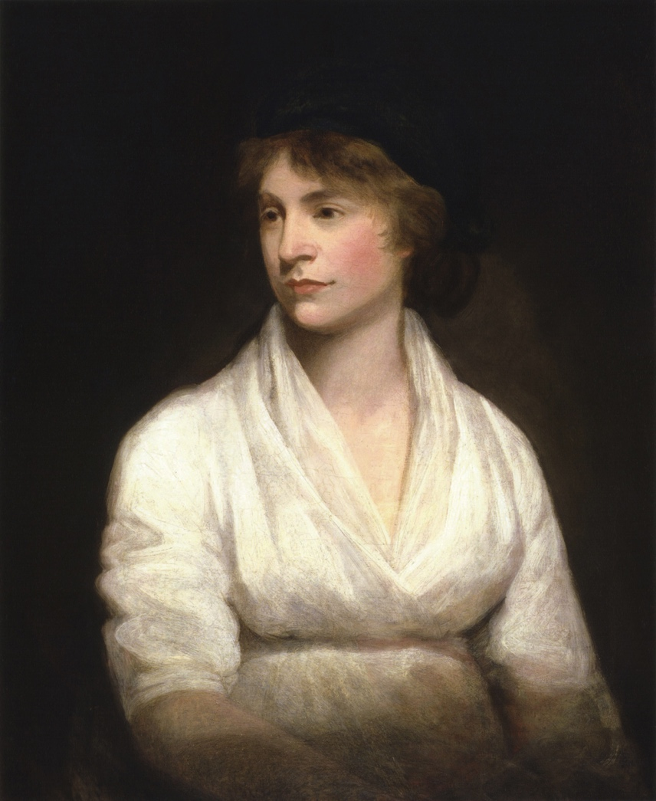
Mary Wollstonecraft
Born in England and supported her family through many different jobs.
Fought for women’s rights and the inequalities of education.
Believed people should be judged based on individual merit and moral virtue, not gender.
Believed women were not a husband’s property and that they should be given equal opportunity when trying to get a job.

