Slide 1
Plessy v. Ferguson and the Rise of Jim Crow

Slide 2
Where we’ve been
Freedmen’s Bureau Act: created a government body to help freed slaves
Reconstruction Act of 1867: militarized confederate zones to protect African American votes and protect freedmen
Civil Rights Act of 1875: everyone, regardless of race or previous condition of servitude, was entitled to same treatment in “public accommodations”

Slide 3
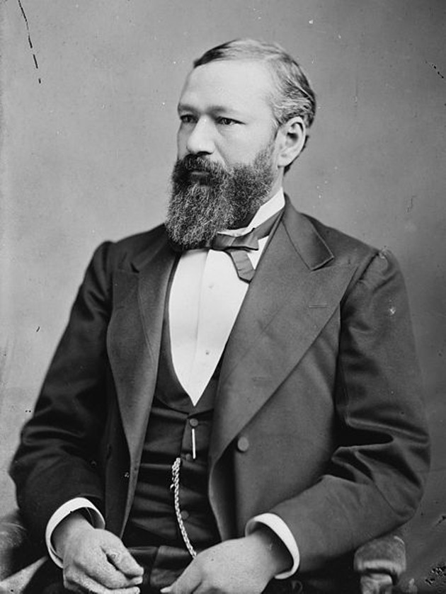
Plessy v. Ferguson 1896
June 7, 1892 Homer Plessy (1/8th black) boarded a train in New Orleans and was told he needed to move to the black car, while he had purchased a white car ticket.
Argued that segregation on railroads was a violation of the 13th and 14th amendments.
The supreme court upheld the decision that the 13th amendment did not protect African American’s from state laws that treated them unequally.
Set the precedent of ”separate but equal”
This extended into all areas of public life and gave federal backing to segregation laws.

Slide 4
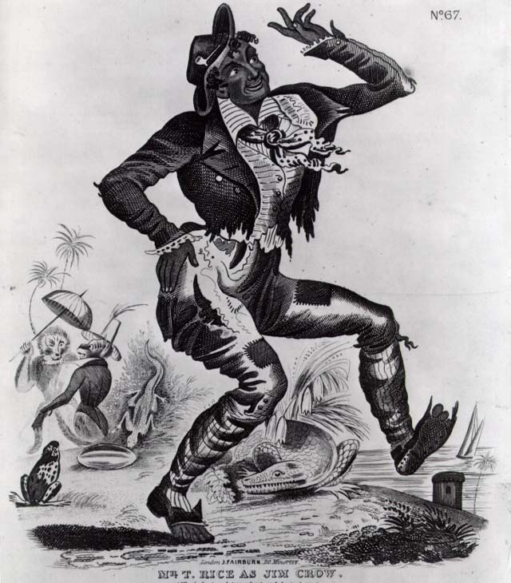
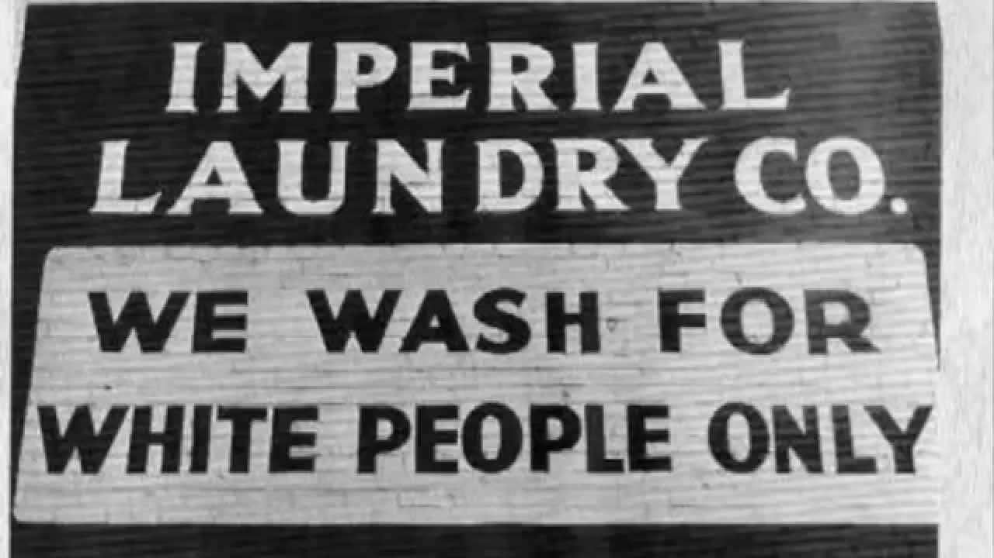
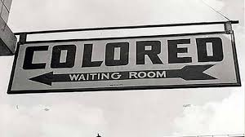
Jim Crow Laws
From 1880s into the 1960s, Black Codes were placed by equally unjust and racist laws called Jim Crow.
After a black character in minstrel shows
States and cities across the south could impose legal punishments on people for breaking Jim Crow laws, focused on keeping the races segregated.

Slide 5
Examples
White motorists had the right of way at all intersections.
Separate schools shall be maintained for children of different races.
Books shall not be interchangeable between white and colored schools.
All railroad companies and corporations are hereby required to provide separate carts for whites and colored peoples.
Any person who is guilty of printing, publishing or presented arguments in favor of social equality are guilty of a misdemeanor.
Any negro man and woman who are not married but occupy the same room at night shall face imprisonment.

Slide 6
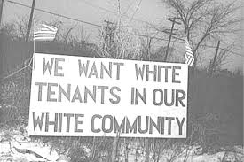
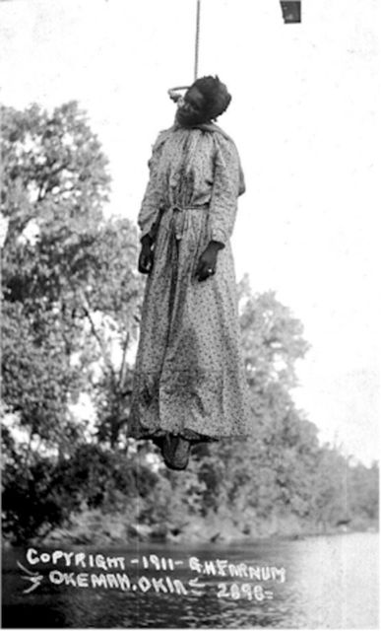
Federal Segregation
Many states in the south established literacy tests as a requirement to vote.
The Congress only contained one black congressman.
Indicative of the growing political strength of the Southern states, Congress abandoned a bill that authorized a federal supervision of elections.
Nationwide, 113 blacks died of lynching in 1891.

Slide 7
Does segregation still exist?
https://demographics.virginia.edu/DotMap/index.html

