Slide 1
Progressive Reform

Slide 2
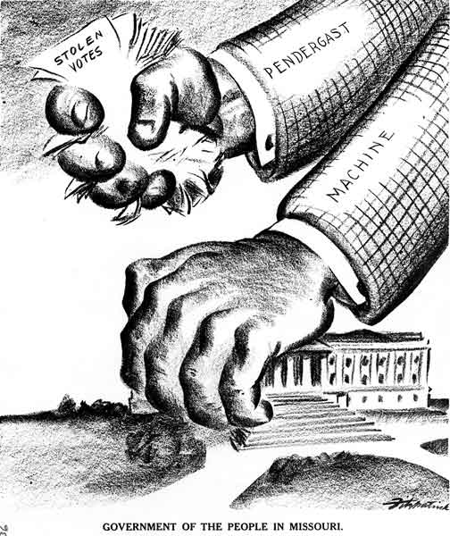
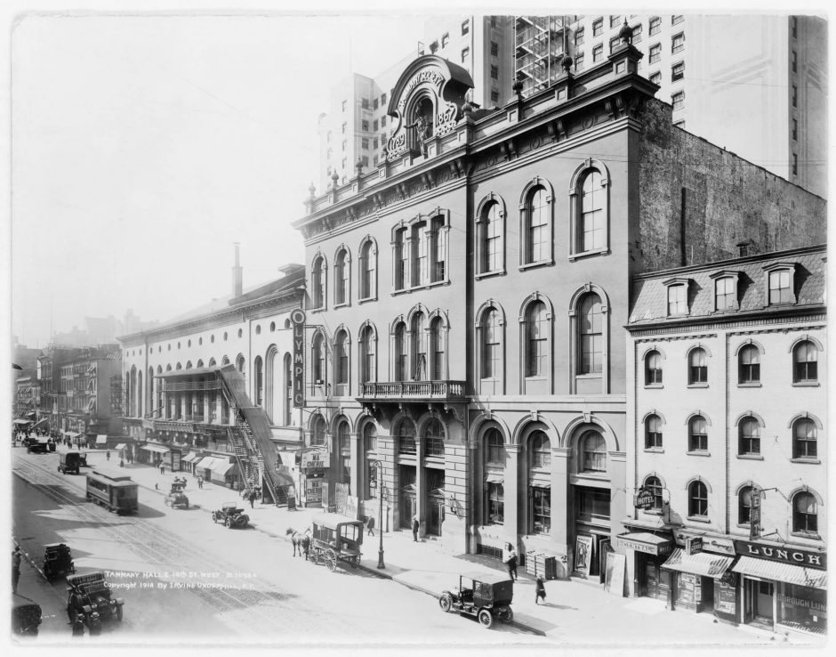
Political Machines
Americans believed that private enterprise spurred innovation so city growth and politics was largely private.
This gave rise to Political Machines
Local party bureaucracies that held tight grip on elections and finance of cities.
Dispensed jobs, arranged urban services, found emergency aid for struggling families.
Debate over whether or not these characters were corrupt.

Slide 3
The Progressives Rise Up
Progressivism was a set of overlapping movements to help combat issues of industrialization
All about civic participation
Jacob Riis, How the Other Half Lives (1890)
Public health
Urban prostitution
Garbage collection
Food and food safety (Upton Sinclair’s The Jungle)
City Beautiful Movement

Slide 4
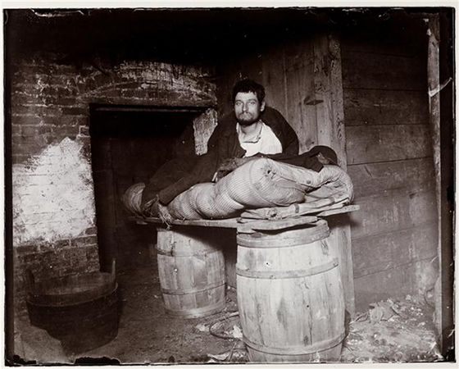
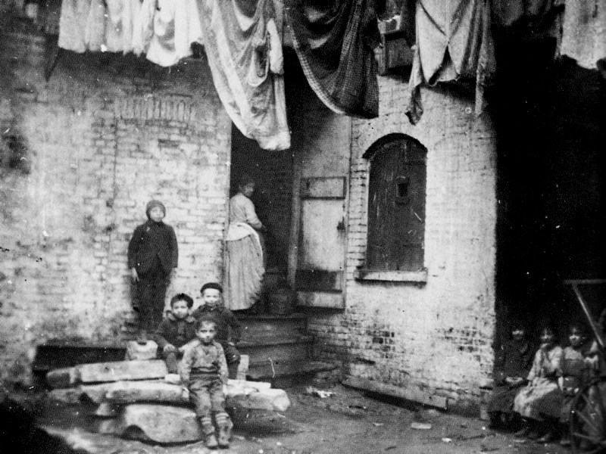
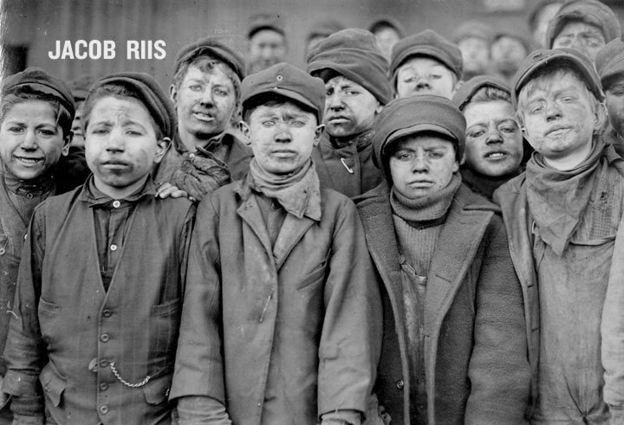
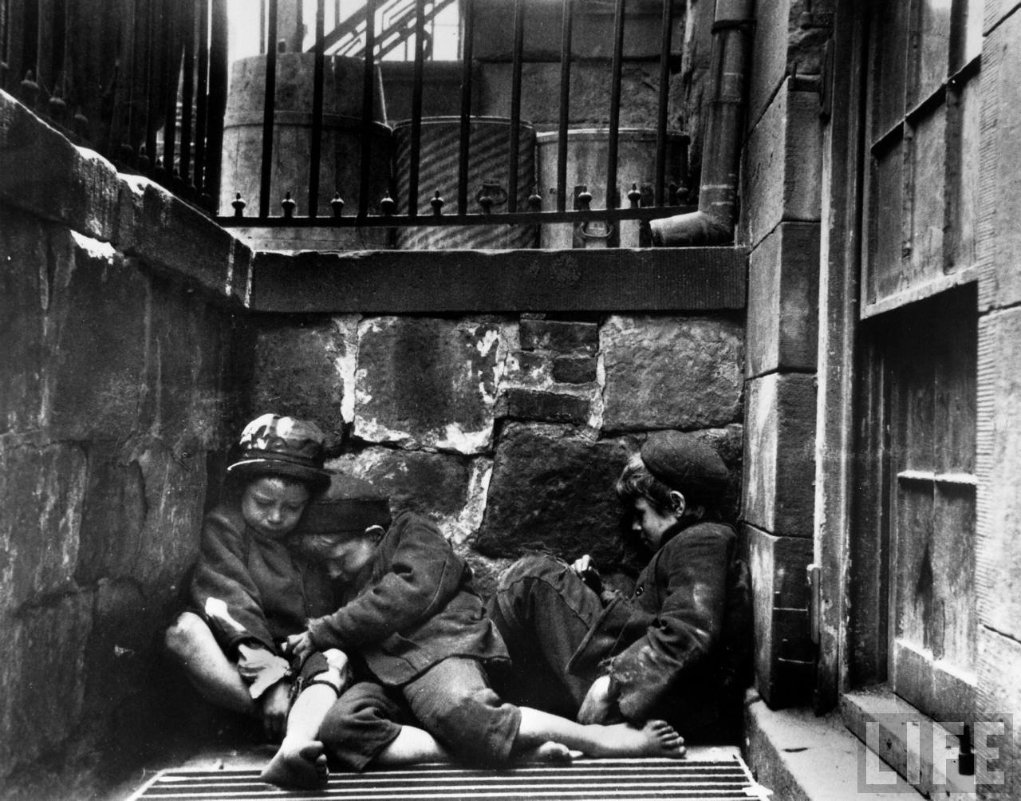

Slide 5
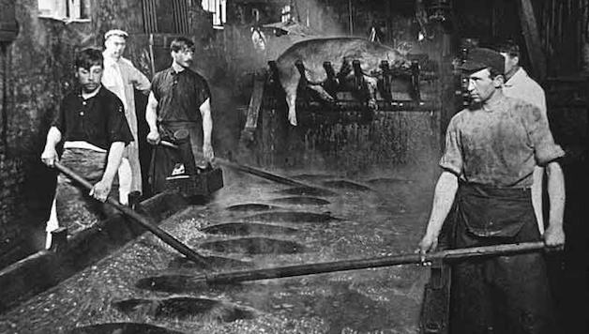
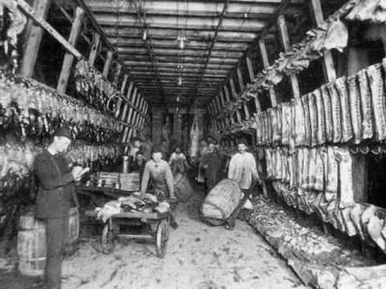

Slide 6
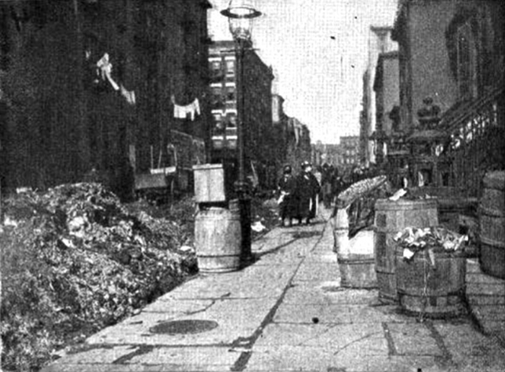
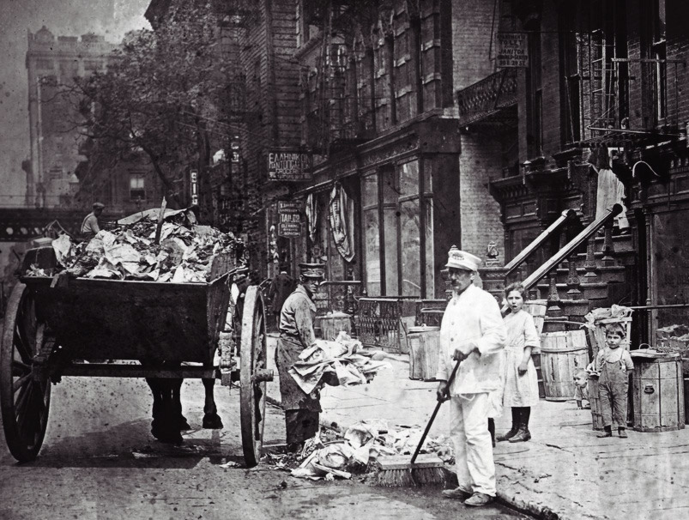

Slide 7
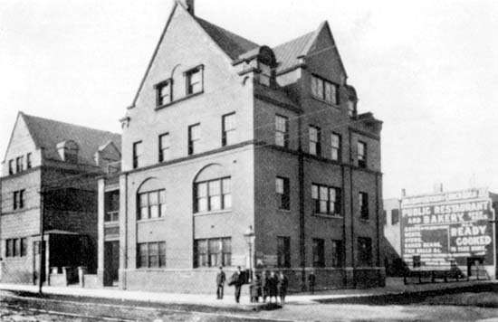
Social Settlements
Community welfare centers that investigated the plight of urban poor and address urgent needs
Hull House in Chicago founded by Jane Addams
Believed urban poor knew what they needed but lacked resources to achieve it
Settlement houses were a spring board for other topics
Margaret Sanger and birth control
Criminal justice system
Social work

Slide 8
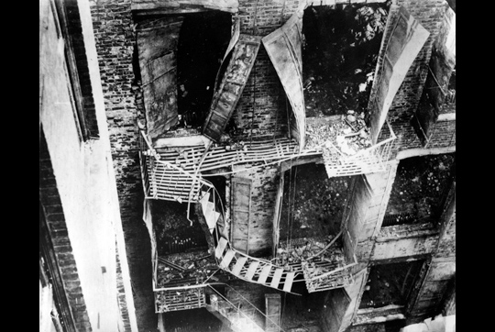
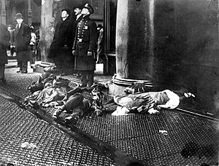
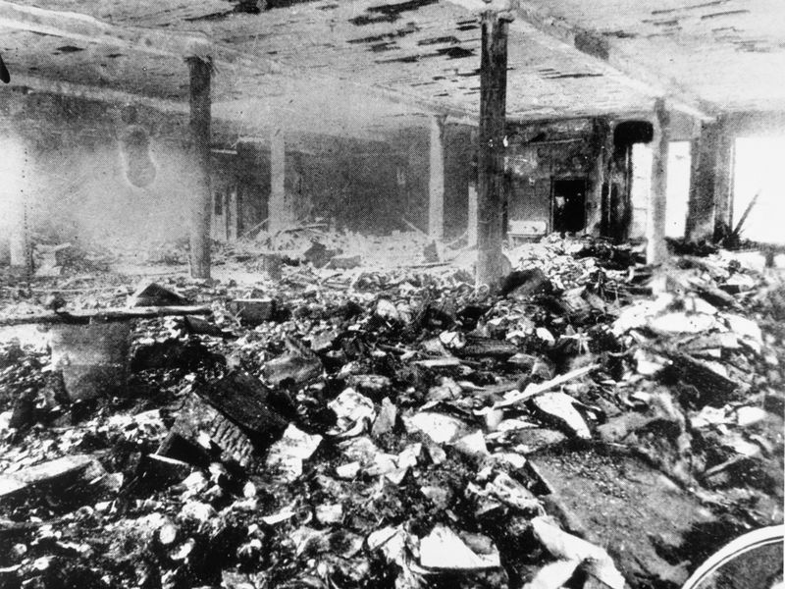

Slide 9
Politics of the City
Residents of industrial cities sough allies in state and national politics
The Triangle Shirtwaist Fire forced New York to create 56 labor safety laws which soon influenced the whole nation.
Industrial cities continued to grow, the political machines could no longer solve the problems.
Needed federal oversight
Broader reform movements continued to build throughout the next few decades.

Slide 10
How should the Federal Government get involved? Should they?

