Slide 1
The Protestant Reformation

Slide 2
Vocabulary
When you PROTEST: to express disagreement about something. To take action or to voice disapproval.
REFORM: to change an established idea (especially with society, politics, or economics) for the better.
So the PROTESTANT REFORMATION: a religious movement that sparked the creation of the new “protestant” churches in western Europe.

Slide 3
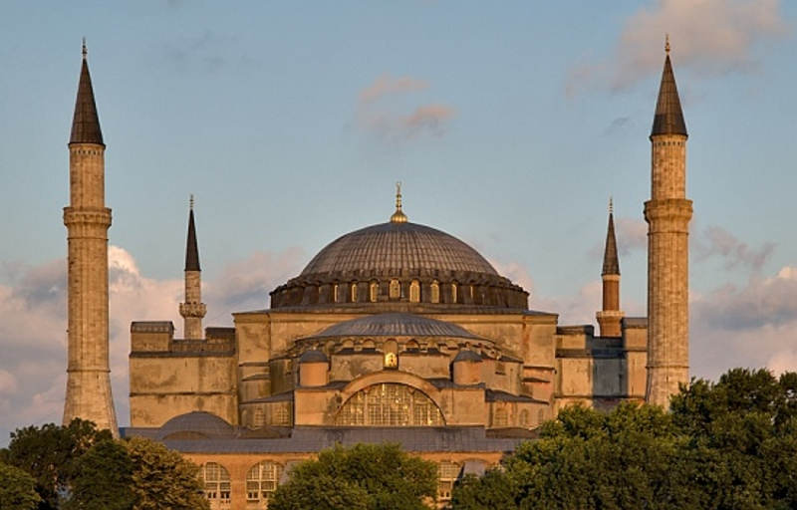
Corruption in the Catholic Church
The church was the most powerful institution in Europe.
Most money, the most knowledge, most influence, and they used it
However, during the Renaissance people began to learn for themselves.
Some of the church corruption came under fire and people started wondering what they were doing and WHY.

Slide 4
Indulgence, Simony and Politics
Indulgences: sold by the Catholic Church as a release from punishment of sins. Saw this is a way to “buy forgiveness”.
People worried that if they could not afford these indulgences they wouldn’t go to Heaven.

Slide 5
Indulgence, Simony and Politics
Simony: selling of church leadership positions, leaders were not chosen based on merit, but on payments.
Wealthy families had the most influence!

Slide 6
Indulgence, Simony and Politics
The power of the Pope: the Pope is the head of the Catholic Church and became VERY powerful.
Pope repeatedly fought with kings over who had the most power and could actually control people.
Who wins? Control of your current day to day life or the after life?

Slide 7
Enter Martin Luther
In 1517 a German Monk named Martin Luther writes the 95 Theses and nails them to the church door in Wittenberg.
These 95 “complaints” outlined the abuses of the catholic church .
This was the first time anyone had called out the church.
Eventually sparked the Reformation and the creation of the Protestant religion.

Slide 8
“86: Again, since the Pope’s income day-to-day is larger than the wealthiest of men, why does he not build this one church of St. Peter with his own money, rather than with the money of indigent believers?”
What is he saying?

Slide 9
Slow Transformation
Not the first to call out the church, but the time was right.
With the invention of the printing press people were able to access and understand information.
People were already questioning the way things were done with the new growth of the Renaissance.

