Slide 1
The Early British Colonies

Slide 2
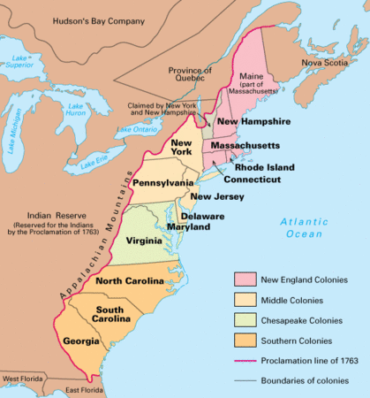

Slide 3
The restoration Colonies
In 1663 Carolina, New York, New Jersey, and Pennsylvania were established as Restoration Colonies.
Largely independent and controlled by proprietors as long as they generally followed English law.
Many policies were put in place to help expand the British economy and give them trade advantages with the colonies.
The Navigation Acts
The Revenue Acts of 1673

Slide 4
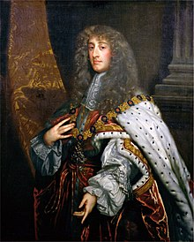
King James II expands British control
James II wanted more formal control of British American colonies
Revoked Connecticut and Rhode Island charters, and created the Dominion of New England (formally Massachusetts Bay and Plymouth)
Banned town meetings, and invalidated land titles given under original charter, colonists now had to pay an annual fee for land they previously owned.

Slide 5
The glorious Revolution
In England, a coup took place and James II was forced to create a constitutional monarchy.
This was inspired by the writings of John Locke (life, liberty, property)
This inspired colonial political leaders to expand power of colonial assemblies (i.e. take power away from monarch appointed governors).
Because of the continual wars England was in, they largely left the colonies alone. This furthered the norm of independent rule.

Slide 6
The south Atlantic System
Britain won thousands of acres of land in the colonies through victories in Europe, and set up a quest for commercial supremacy.
Focus was on new agricultural products and slaves.
England made a TON of money and helped them become an economic world leader
Slavery became a core institution in the colonies

Slide 7
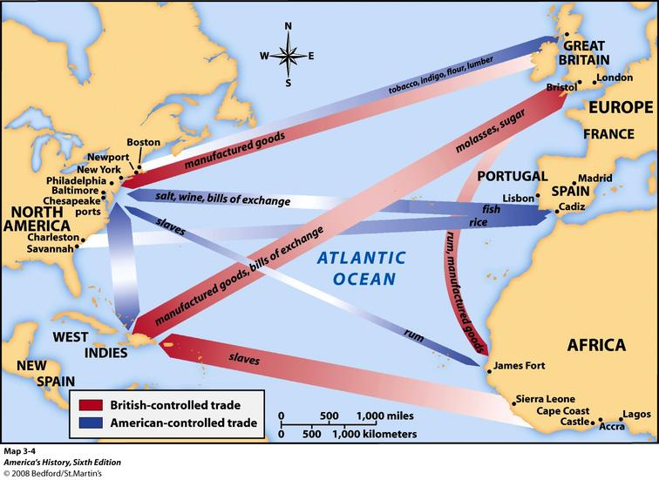

Slide 8
The rise of colonial assemblies
The colonies continued to limit the power of crown officials
Took the power to tax and make government appointments
Because of salutary neglect, these assemblies gained power and Britain largely let them have internal affairs.
These assemblies were responsive to people and increased resistance to British control.
This was the foundation of the American independence movement.

Slide 9
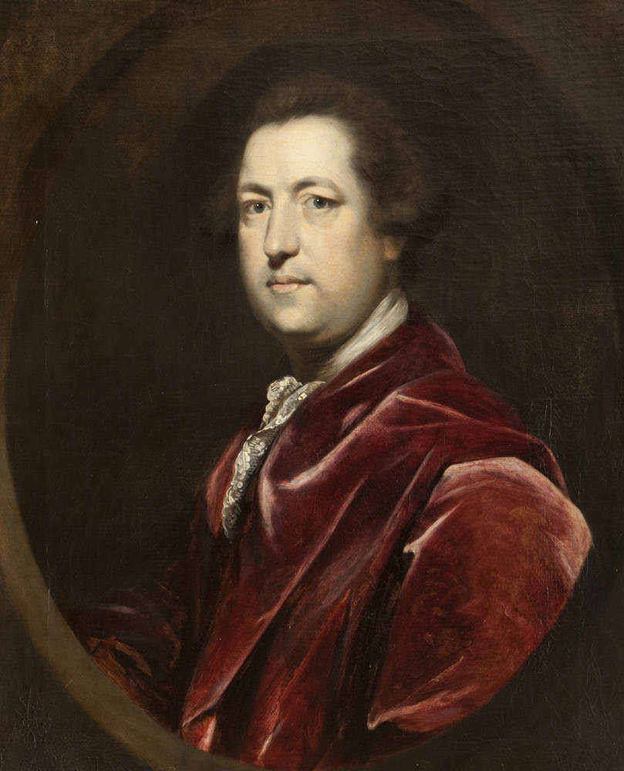
Restrictions increase
Parliament tried to prohibit colonies from manufacturing items, with the goal of stifling colonial economy (it was all about control and money)
Colonies were drained of money, couldn’t borrow money or sell goods.
Anger and tension in the colonies starts to brew.
Charles Townshend gains power in England and vows to create more control of the colonies.

Slide 10
Wheel of Empire
1650s: England sets out to create a centrally managed Atlantic empire and slowly achieve aspects of their goal.
Internal unrest and salutary neglect weakened British control of colonies.
1740s: Britain recognizes the threat of self government and vows to reassert power.

