Slide 1
A Republican Empire

Slide 2
Immigration through the country and relations with Native Americans
Many wanted to take away Native American land in the early 1800s, the problem was most native tribes did not recognize their right to the land but the tribes were not present to sign the Treaty of Paris.
The Treaty of Greenville made the Native Americans accept American sovereignty over them
Three migration waves took place:
White tenant farmers and struggling yeomen went to Kentucky and Tennessee
Movement of southern planters towards the Gulf of Mexico
Movement out of overcrowded New England cities

Slide 3
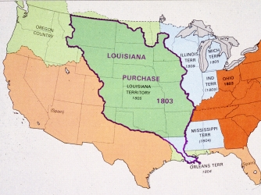
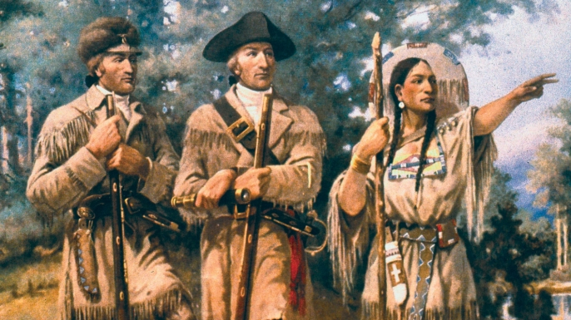
The Jefferson Presidency
Pursued policies that made it easier for farm families to acquire land
The Louisiana Purchase
Doubled the size of the U.S. for 15 million dollars
Increased political party conflict
Lewis and Clark

Slide 4
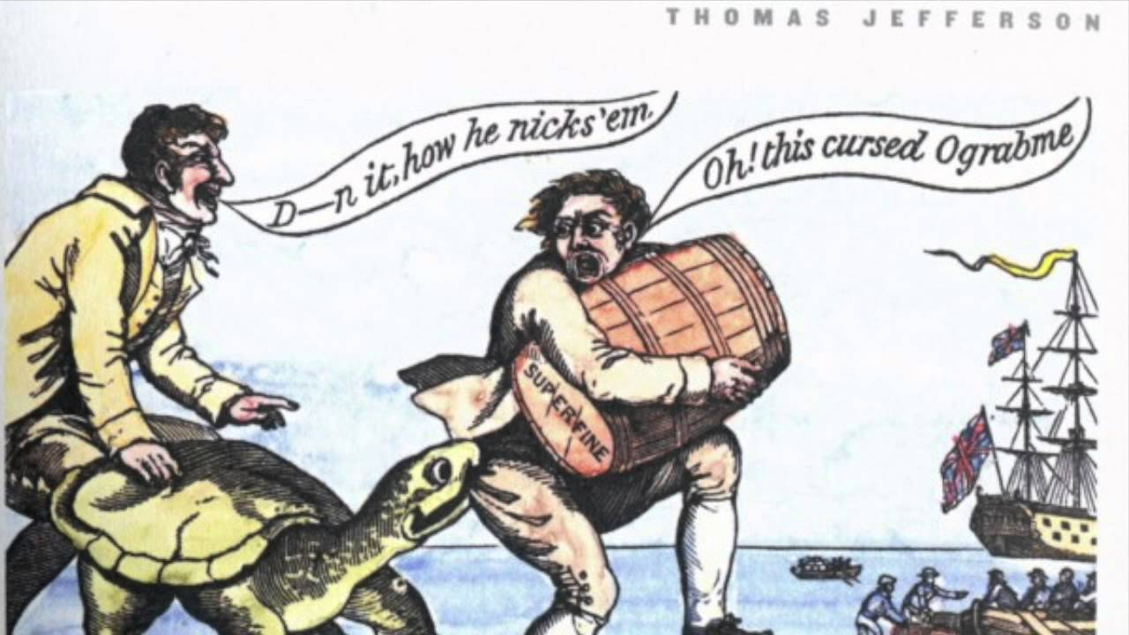
Beginnings of War
Europe struggled with the Napoleonic Wars
The U.S. tried to stay neutral but Britain began seizing American ships
Jefferson passes the Embargo Act of 1807
Prohibits ships from leaving until Britain and France stopped restricting trade
Didn’t work
Meanwhile, Britain was trading and working alongside many western Native groups
Tecumseh, William Henry Harrison, Battle of Tippecanoe

Slide 5
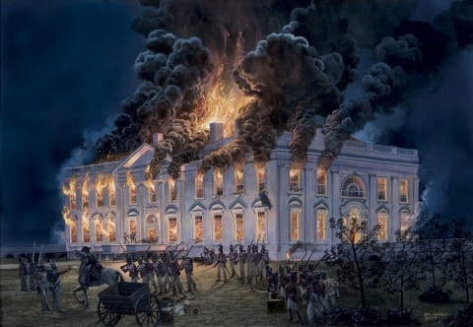
War of 1812
Eventually the United States declares war against Great Britain.
The war created more political division and slowly the British began to take control
Burning of the capitol
However, the British wanted peace, so they signed the Treaty of Ghent in 1814
Jefferson’s Republicans split in half after the war
One side took on more federalist policies
Other side stayed involved in states rights

Slide 6
The Monroe Doctrine
John Quincy Adams and James Monroe
Created American national policy with respect to the western hemisphere
Keep European hands off Latin America republics and America would stay out of European affairs
Formally acknowledged the northern and western borders of the United States

Slide 7
Second Party System
Republican party split between the national faction and the Jeffersonian faction
National minded: Whigs
State minded: Democrats

