Slide 1
The rise of corporate America

Slide 2
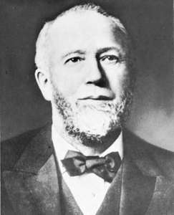
Industrialization grows
Growing populations, expansion west and integrated economies help large corporations become the dominant form of business.
Management Revolution
Systems to help manage massive new industries
Departmentalization, increased communication, executive division
Took advantage of North America’s natural resources
Gustavus Swift invented the assembly line: increase production at lower costs

Slide 3
Vertical and horizontal Integration
New method of vertical integration where a company controlled all aspects of production from raw materials to finished goods.
Horizontal Integration: gaining control of all competitors companies and merging them into one large entity.

Slide 4
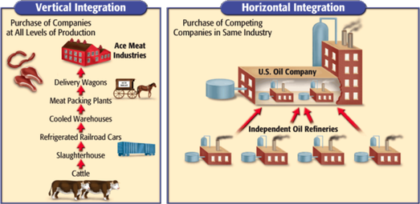

Slide 5
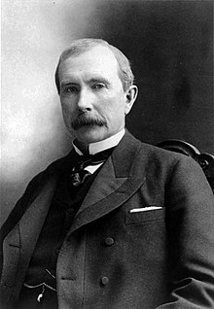
Rockefeller and the rise of the trust
John D. Rockefeller became the king of petroleum.
Used vertical and horizontal integration his firm, Standard Oil controlled all aspects of petroleum production and distribution.
By the 1880s controlled 95 percent of nation’s oil reforming capacity
Created the Trust in 1882
Organized group of associates to hold stock from a group of combined firms, managing them as a single entity
Some denounced “the trusts” and worried about rise of new monopolies

Slide 6
Robber barons vs. industrial statesmen
Men like Rockefeller and JP Morgan were controversial and opinions changed based on economic status
Term “robber baron” developed when economy was in a downfall
In times of prosperity they were known as “industrial statesmen”
They were part of the systematic transformation of the economy

Slide 7
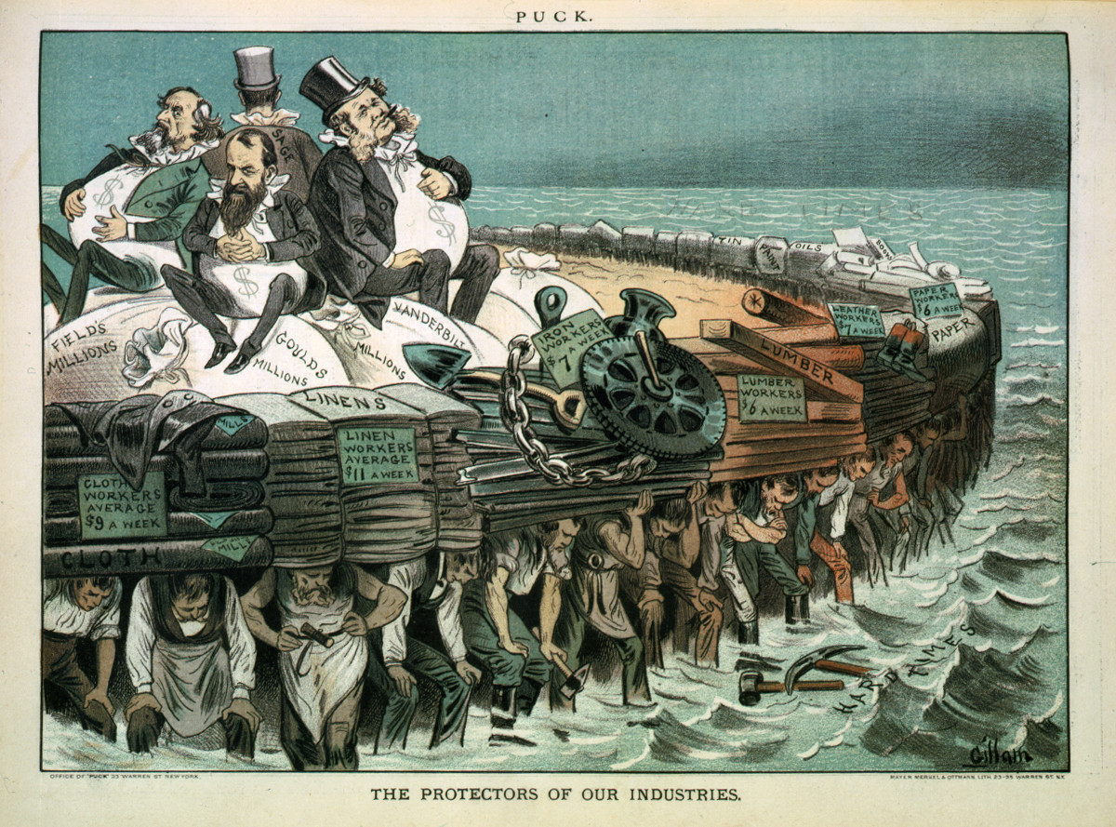
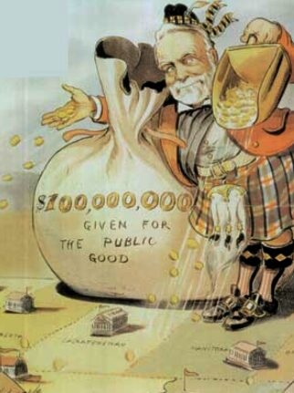

Slide 8
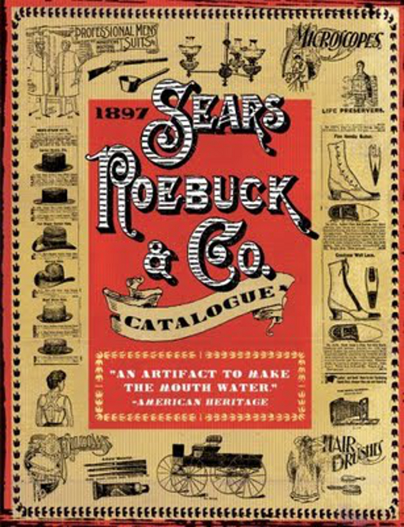
Mass markets
Mass markets brought an appealing array of goods to consumers who could afford them
Created new enterprise of advertising: print, billboards, magazines, mail order companies
Rise of the department store displaced small retail shops

Slide 9
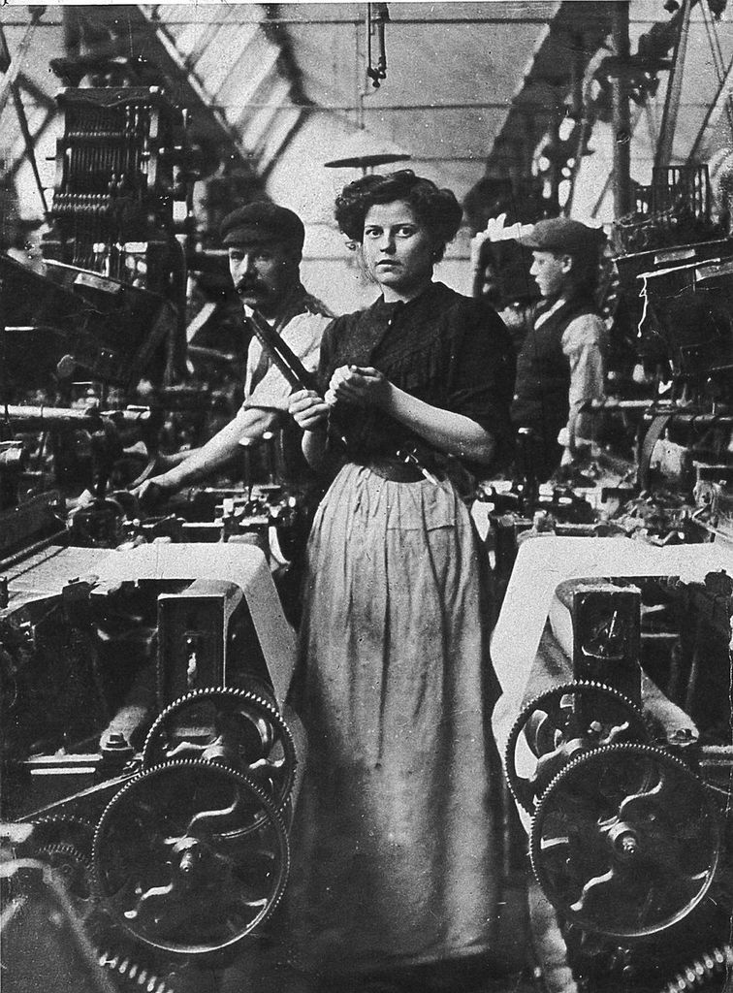
Corporate workforce and the role of women
White collar vs. Blue collar
Sales became systematic with large cooperation's dividing up specific tasks and directing flows of goods and labor
A new class of female office workers rose as clerical and office work became popular for white women.
Black women were excluded from the work place and most continued to work in domestic labor
Men pushed against this and fought hard to exclude women from industry work.

Slide 10
Automation continues
Workers increasingly lost independence as a characteristic of craft work because of:
Deskilling of labor
Mechanized manufacturing
Henry Ford coined the term ”mass production”
Automated machinery increased output and helped control workers and cut labor costs
Brought the nation cheaper products, increased variety and made the United States an industrial power.

Slide 11
The rich and the poor
Cooperation's created a wide gap between the managers (white collar) and laborers (blue collar).
Blue collar workers had little freedom to negotiate and working conditions deteriorated as mass production grew.
Three economic classes
The wealthy elite
Emerging self defined middle class
Struggling working class
Increased debate of inequality

Slide 12
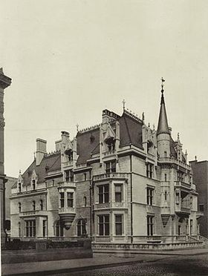
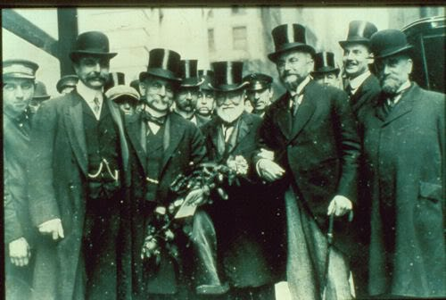
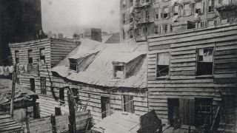
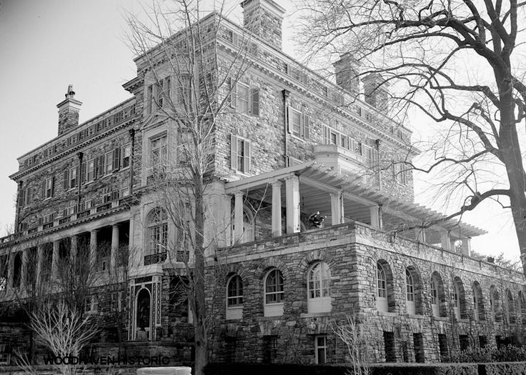
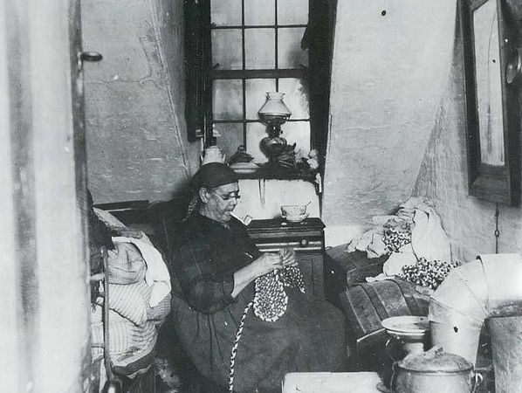
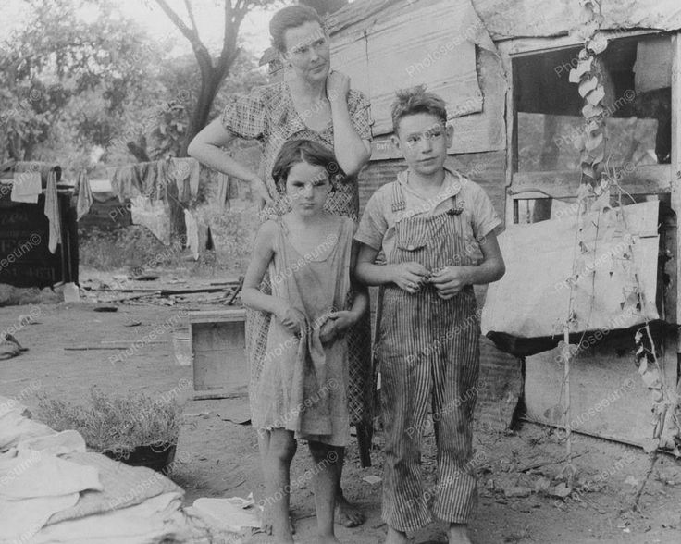

Slide 13
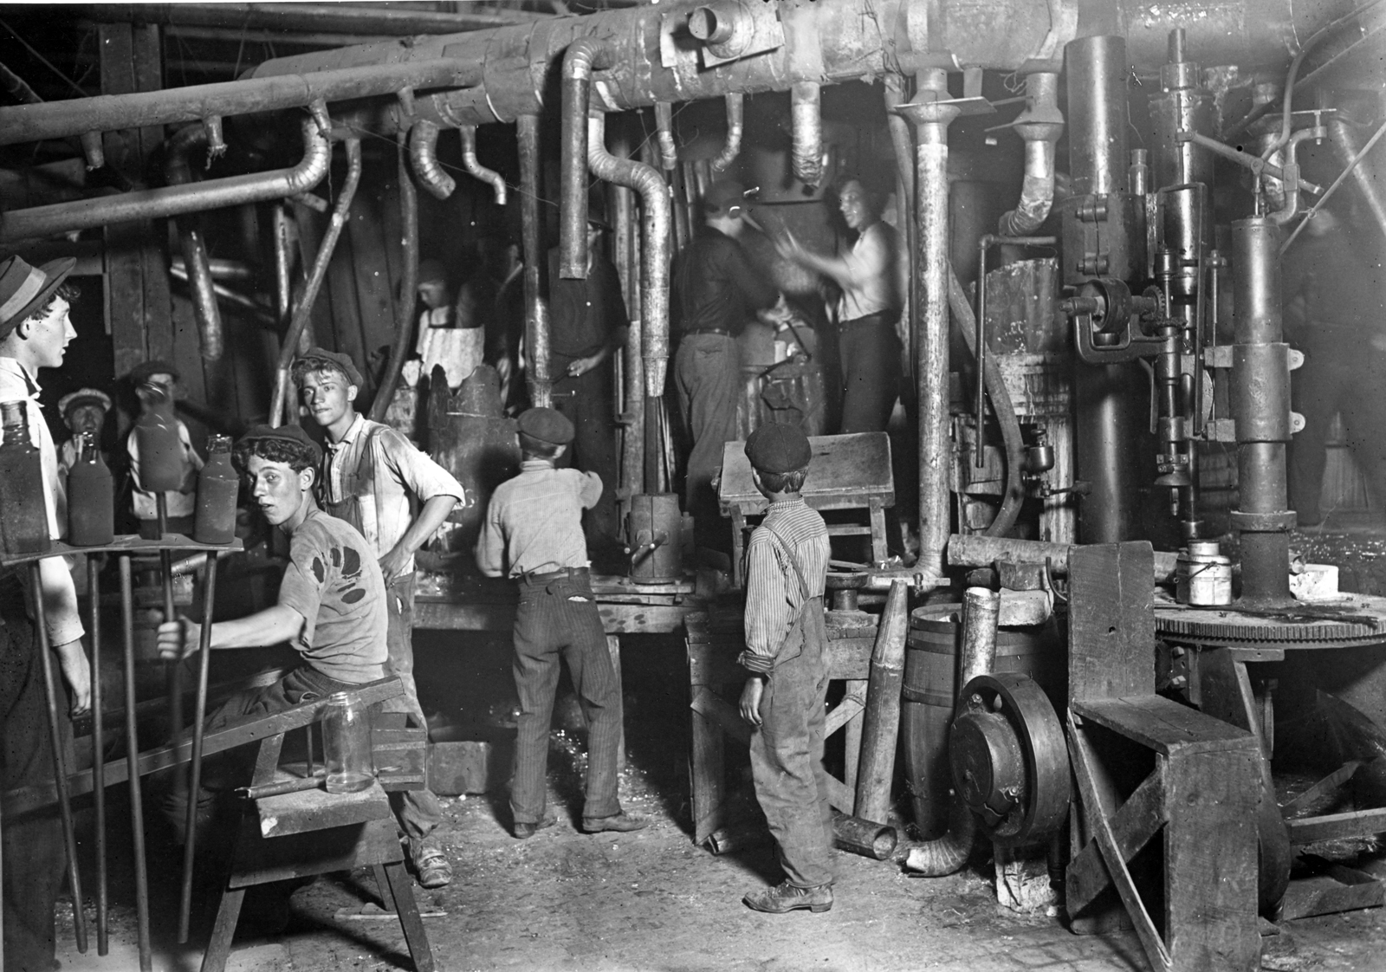
The rich and the poor
Lack of regulatory laws and inspections created extremely unsafe jobs and conditions.
Women and children were increasingly hired as unskilled, low payed work.
One out of every five children under the age of 16 worked outside the home by 1900
African Americans were still largely excluded
Looked to a new kind of low wage labor: the immigrant

