Slide 1
The Political Rise of the Republic

Slide 2
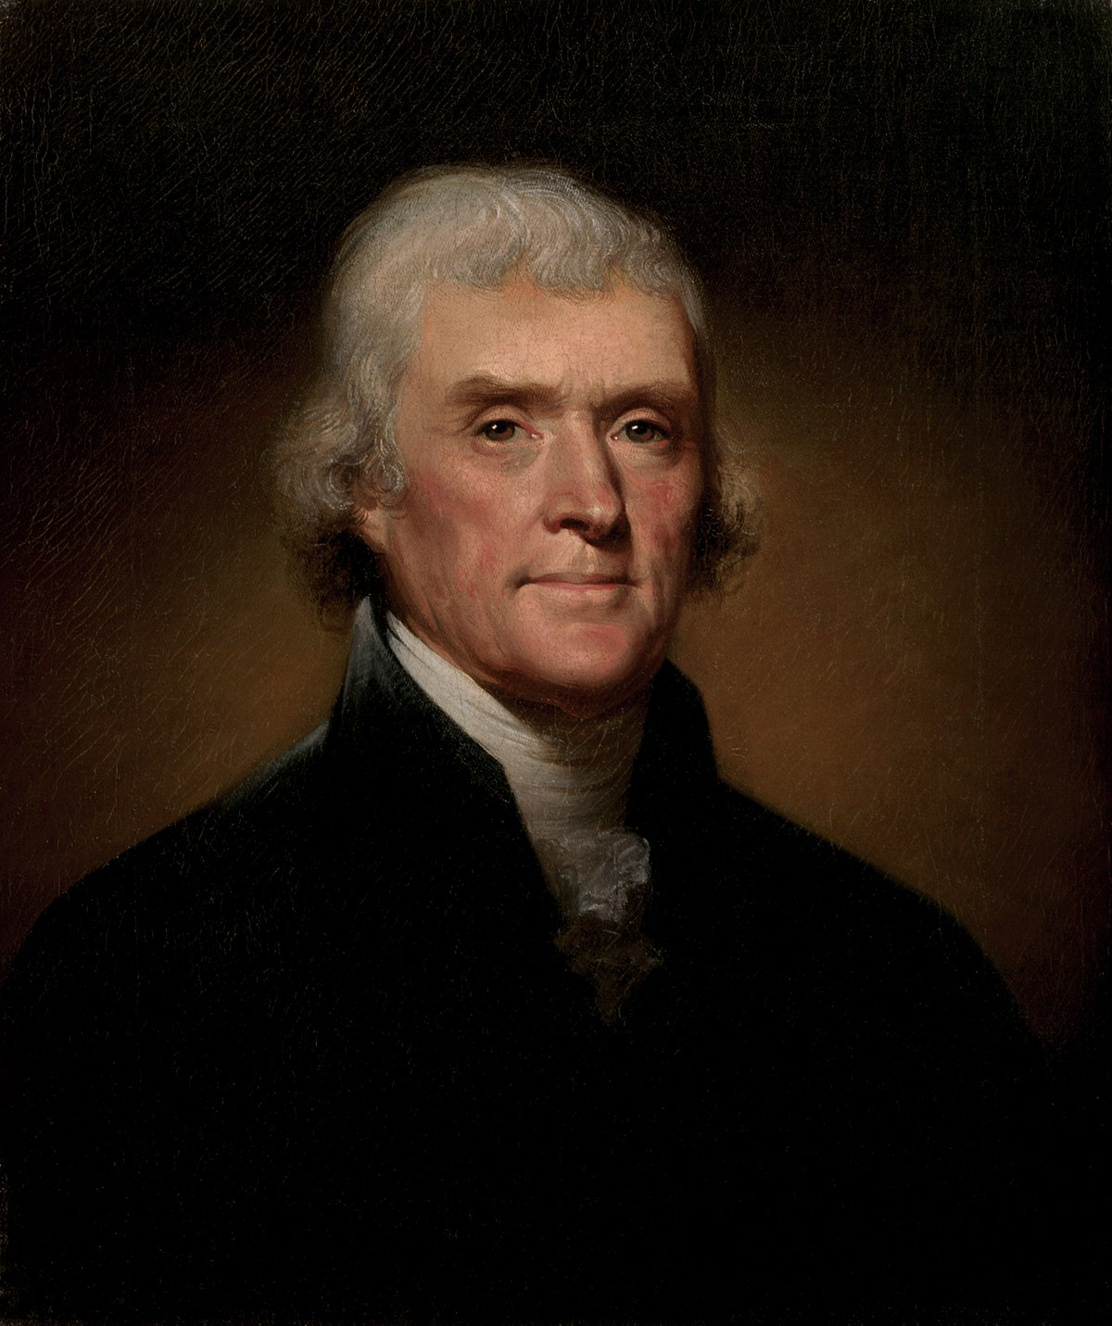
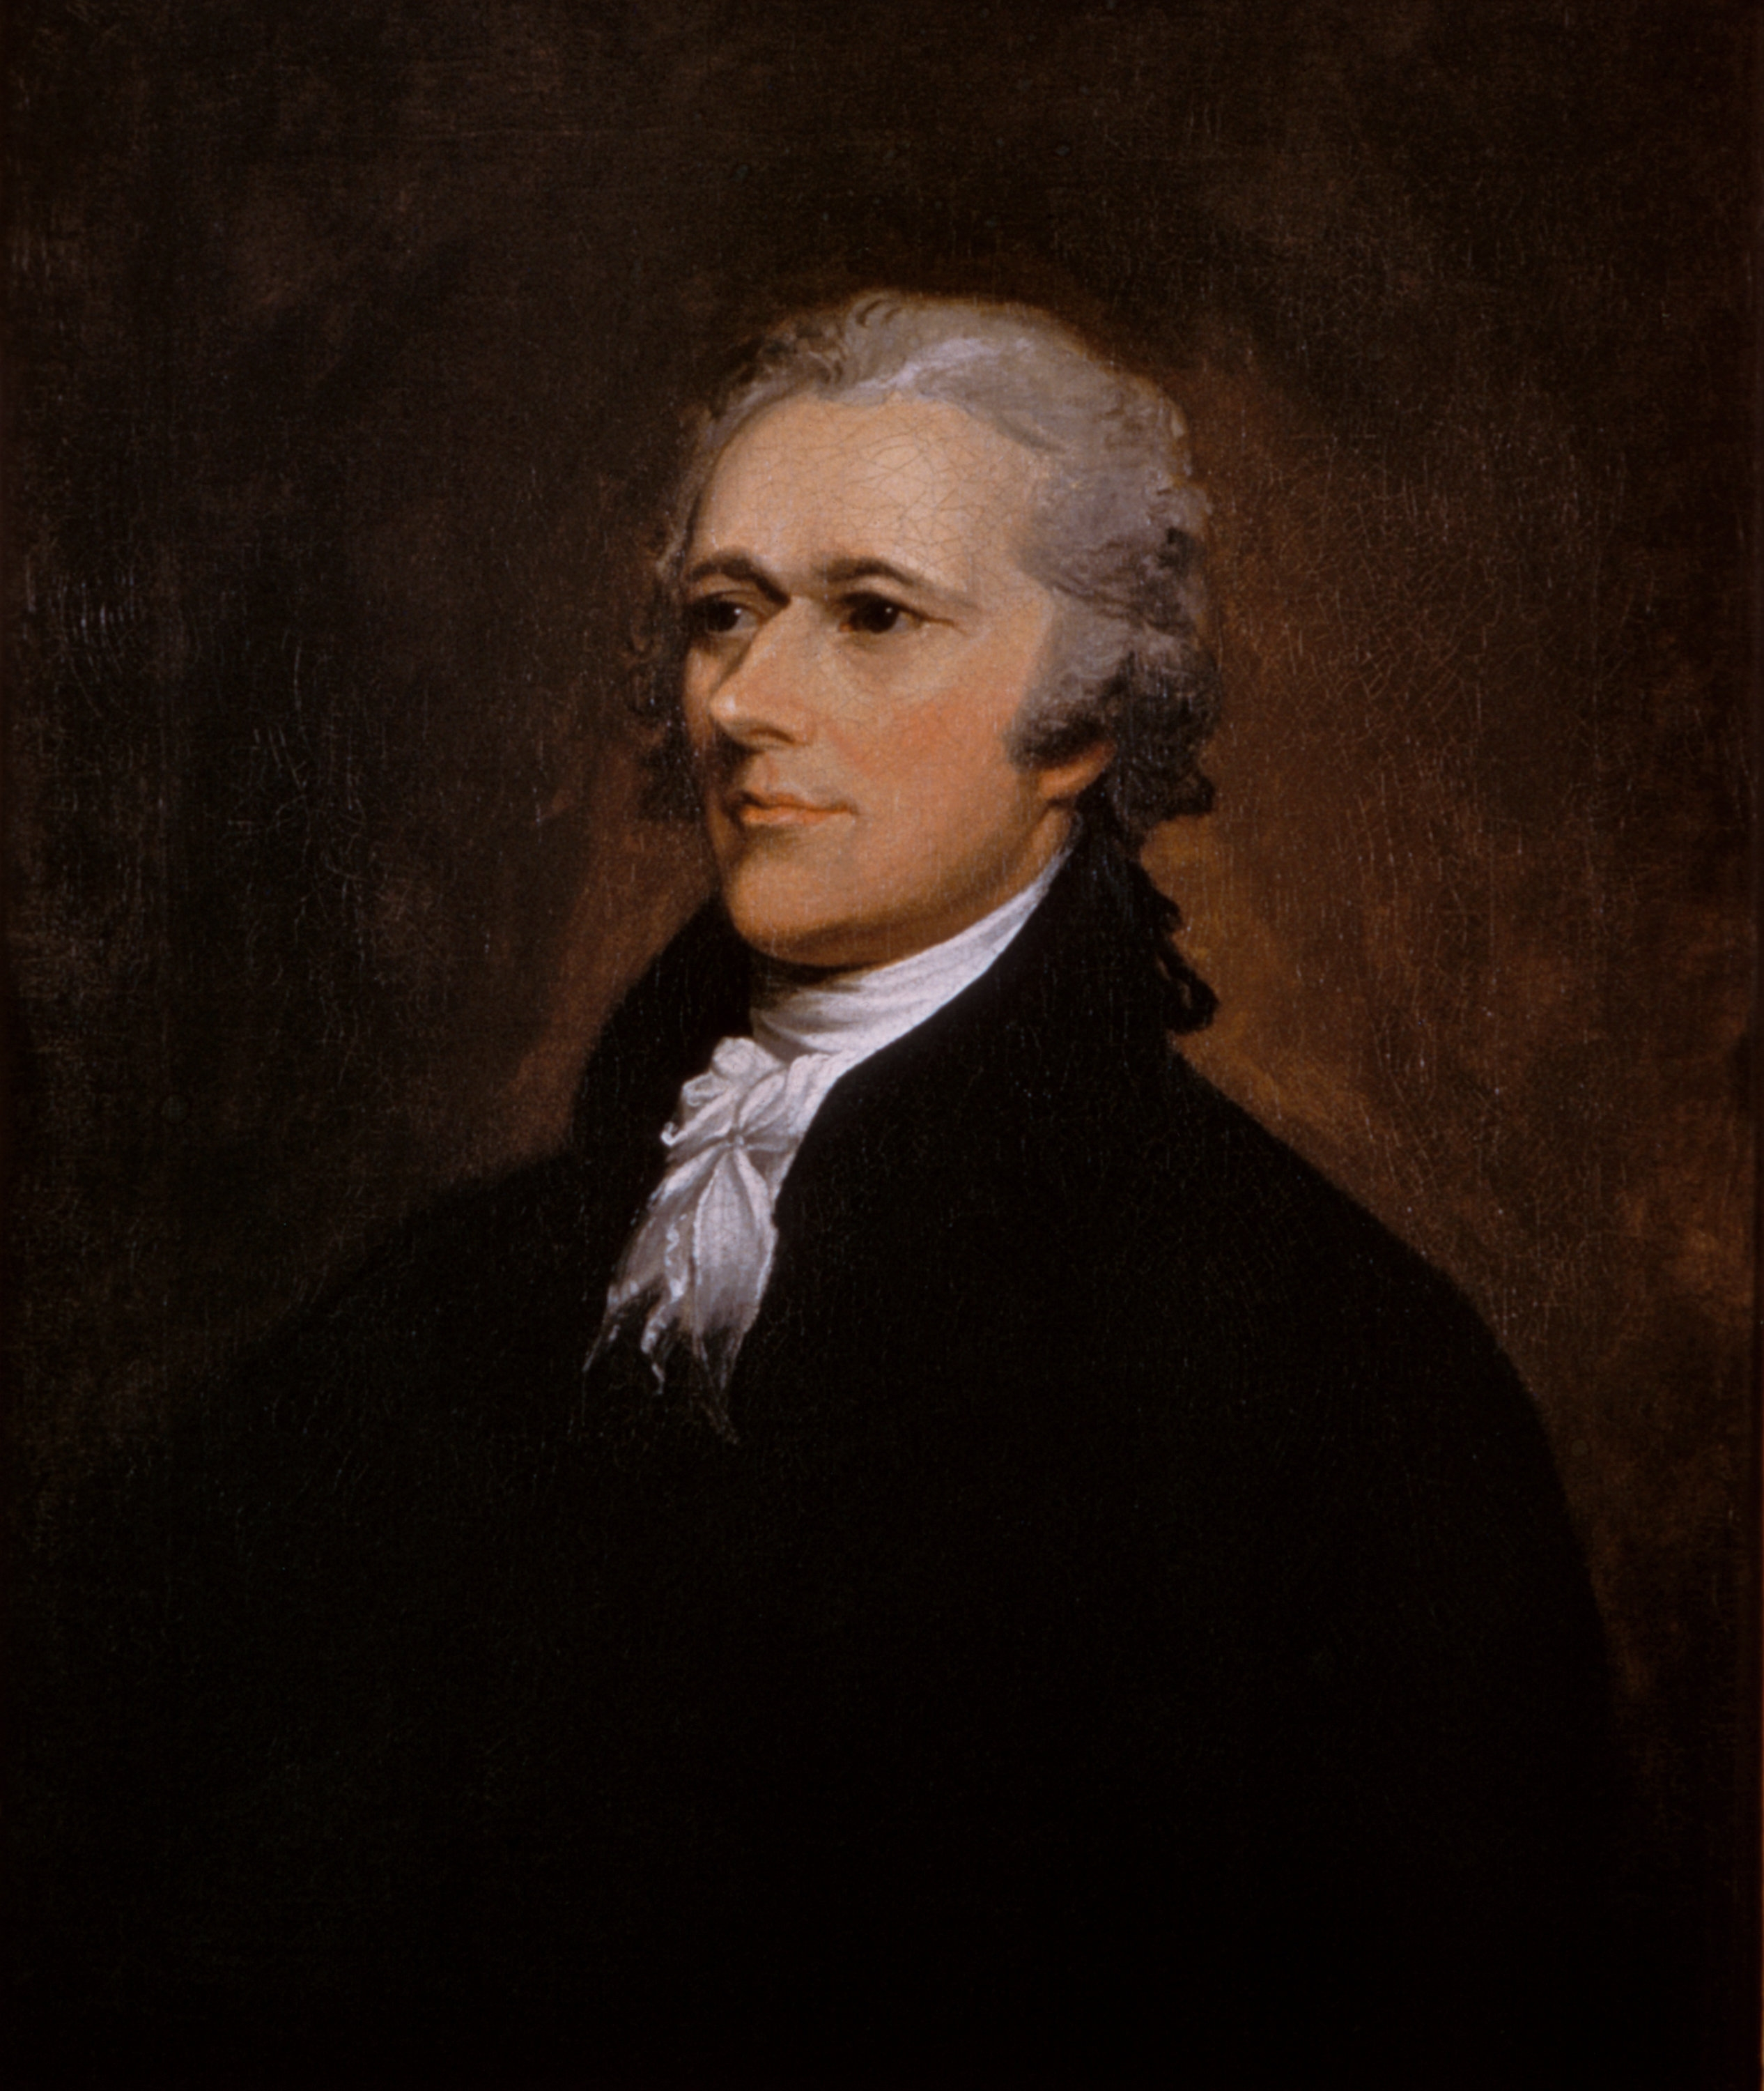
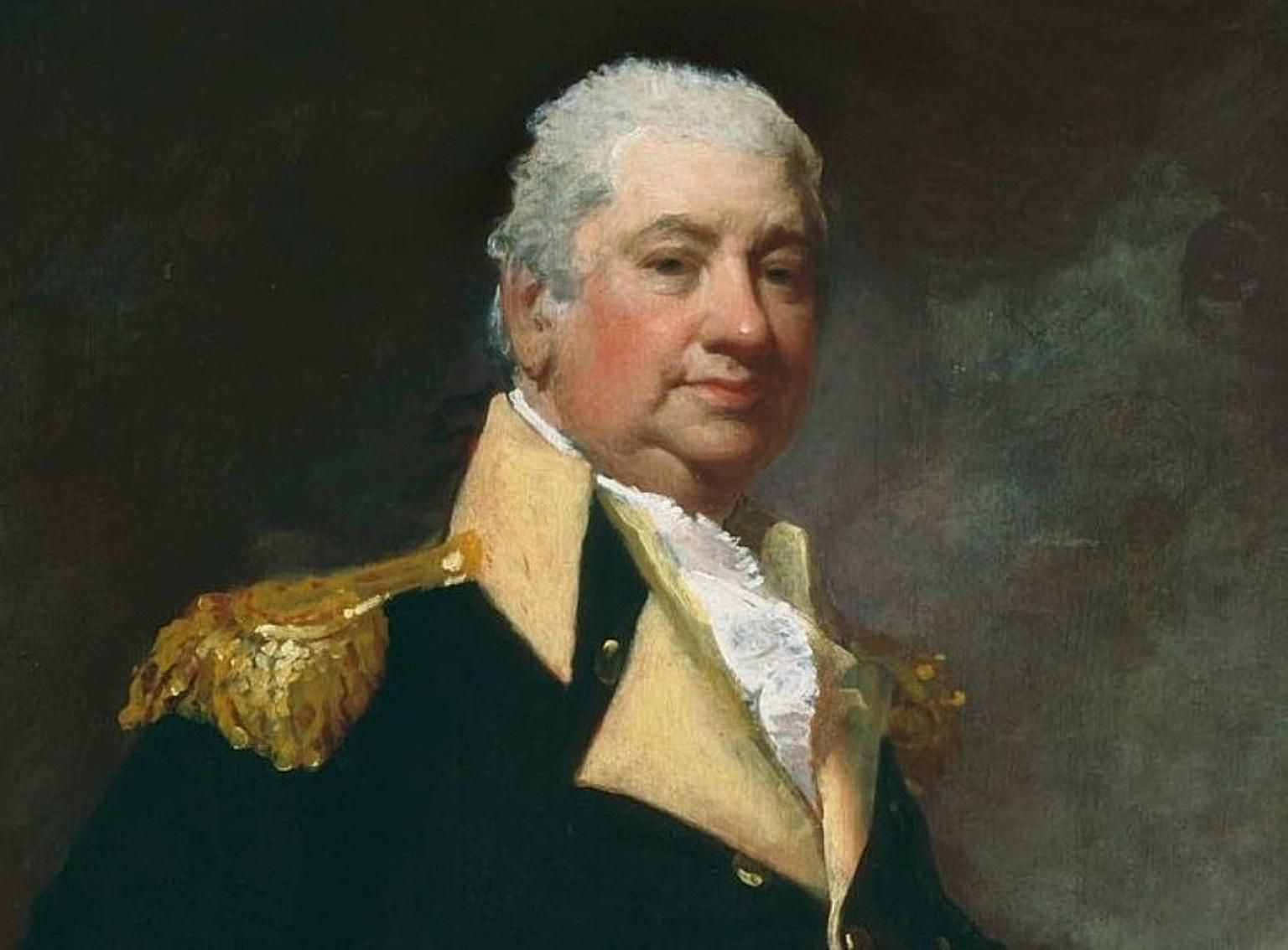
The first federal government
The Federalists won almost all of the seats in the first election
People were still weary of the Articles of Confederation and lack of national control, so many favored the Federalists
President: George Washington
Department of State: Thomas Jefferson
Secretary of Treasury: Alexander Hamilton
Secretary of War: Henry Knox
Did pass the Bill of Rights (first 10 amendments of the Constitution) to please the anti-federalist

Slide 3
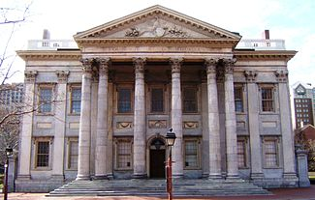
Hamilton and America's finances
Alexander Hamilton was very anti-states rights. Wanted a central government that was almost authoritarian that held control of almost all aspects of government life
Set forth a series of three reports about the American finance system
Report on the Public Credit: redeem securities held by investors (give America better credit aka more loans available)
National Bank Charter: create a state owned national bank
Report on Manufactures: expansion of American manufacturing with revenue tariffs to pay interest on national debt

Slide 4
Jefferson and the republicans
Federalists split in half over the question of Hamilton’s banking finance system
Pro Hamilton: northern federalists
Anti-Hamilton: southern federalists led by James Madison and Thomas Jefferson
Spoke for the Western farmers and Southern planters
Wanted America to be run by small, independent farms.

Slide 5
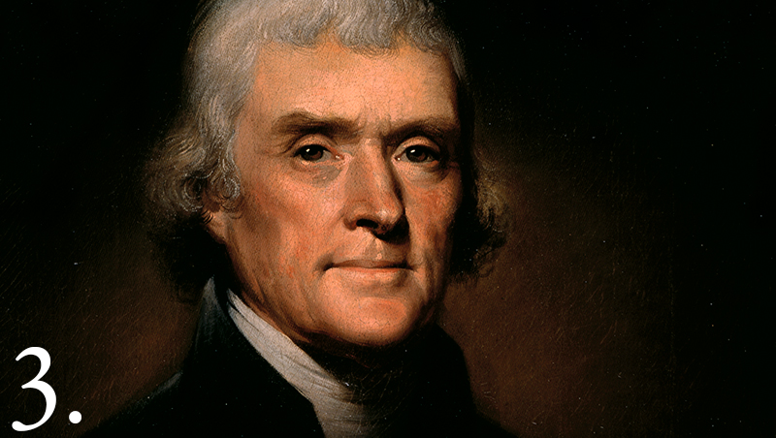
Rise of the two party system
The Federalist and the Republicans became the first party system
Merchants and creditors were the Federalists
Southern tobacco planters and rice farmers were Republicans
This was solidified in the 1796 Presidential election

Slide 6
REPUBLICANS TAKE CONTROL
In the 1800 election it was a bitter contest and Jefferson won after a tie with Aaron Burr
Known as the Revolution of 1800 because it was a peaceful transfer of power from one party to the next.
For the next 25 years Republicans would control the White House and restructure a lot of the Federalist policies

