Slide 1
The rise of Adolf Hitler

Slide 2
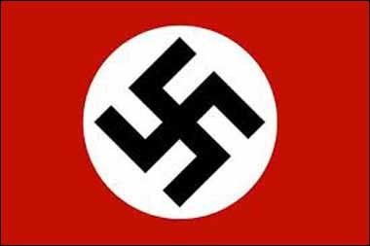
Post War
In 1919 Hitler joined the German Worker’s Party and quickly became obsessed with its success.
In 1920 the party changed its name to the National Socialist German Worker’s Party (Nazi’s).
The swastika became it’s symbol; and Hitler became leader in 1921.

Slide 3
Goals of the Party
The Union of all German’s in a greater German Reich.
Rejection of the Treaty of Versailles
Demand for additional territories for German people (Lebensraum).
No Jew shall be considered German.
Reconstruction of the education system.
Strong central government
https://www.youtube.com/watch?v=jhz8gSY6TtY

Slide 4
Hitler becomes chancellor
By 1933 the German Republic was at a standstill: people were without food, without jobs, and desperate for relief.
In January of 1933 Hitler was chosen as Chancellor of the Third Reich.
Within weeks Hitler became the ultimate dictator and set forth his plan to make Germany the most powerful country in the world.
https://www.youtube.com/watch?v=KqBEJweLV5s

Slide 5
Third Reich controls Germany
Appealed to a sense of nationalism by recalling German glories.
Launched large public work programs: rearmed the military and created an alliance with Italy and Spain.
Directly went against Treaty of Versailles.
Growing concern from Western democracies.

Slide 6
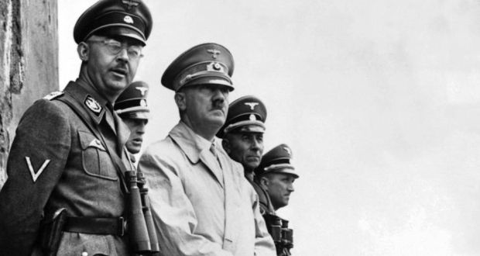
Third Reich controls Germany
Organized a secret police called the Gestapo to monitor all aspects of German life.
Creates massive youth camps to educate German youth about Nazi aims.
Began executing his ideas of the Final Solution and the extermination of the Jewish race.
Lebensraum: wanted to expand German land into small, weak, Eastern European countries.
Profits rose, unemployment dropped, and standard of living increased.

Slide 7
