Slide 1
The Antebellum South

Slide 2
The Domestic Slave Trade
As the borders of the United States expanded, so did the number of slaves.
Most of these slaves were working in the Chesapeake region but began to move south with population increase, as well as increased agricultural production.
The Coastal Trade and the Inland trade
The “mania for buying Negros” from the upper south resulted in the massive transplantation of more than 1 million slaves to the deep south

Slide 3
Expansion of Slavery in the South

Slide 4
Slave Trade Routes

Slide 5
Impact on Black Lives
Slave trade and African American migration took place as transfer or sale
Southern slave traders made massive profits. Used the chattel principle as the primary method of migration
Auction houses were common and families were often split up.
Slave property: the idea that slaves were private property of the owner underpinned the entire economic system
Key for slave discipline
Some planters considered themselves "benevolent masters” and took care of slave families, while others were honest about the human toll their wealth took.
https://www.youtube.com/watch?v=GDCbJ2KL_fs

Slide 6
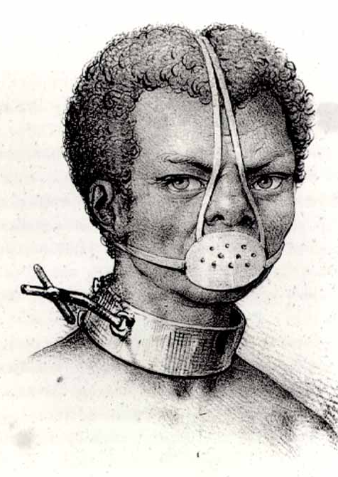
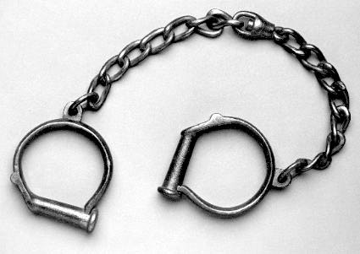
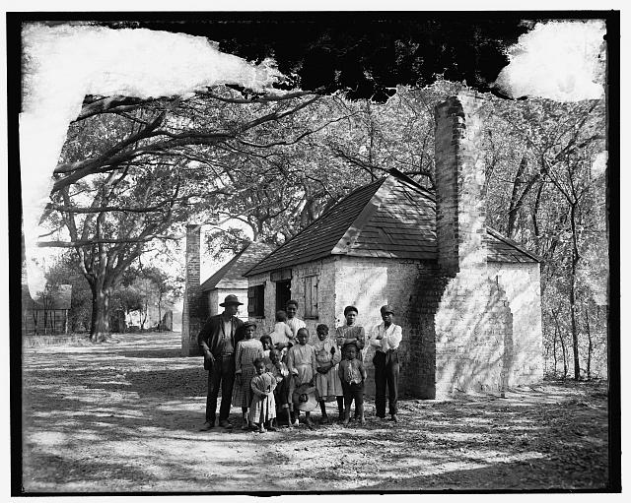

Slide 7
Two Cultures of the Planter Elite: The Republican Aristocracy
Continued expansion split the plantation elite into two groups:
Traditional aristocrats of the Old South
The upstart capitalist of the cotton states
** this was a small number of the population in the South, a small elite owned a vast majority of the slave population
The Republican Aristocracy
Impressive mansions and culture of the English gentry
Criticized the middle class
Married within aristocratic planters and wealthy families
Often justified slavery as a “positive good” because it subsidized their elegant lifestyle and provided training for “genetically inferior Africans
Most were absentee owners
https://www.youtube.com/watch?v=me9b8V2XRU0

Slide 8
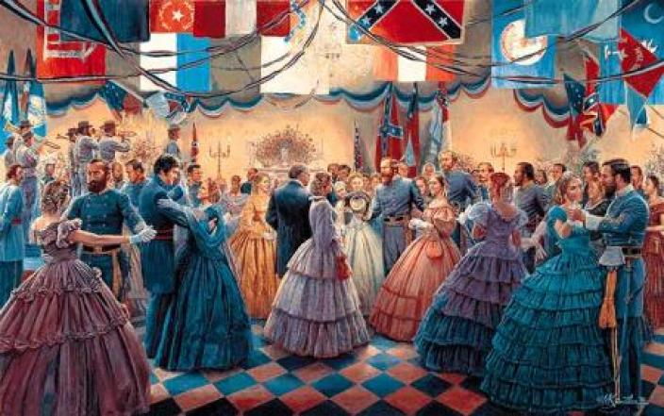

Slide 9
Two Cultures of the Planter Elite: Entrepreneurial Planters
Much less elegance and hypocrisy among this group.
Overseers pushed workers hard because salaries often depended on the amount of cotton they were able to produce
Cotton had a long growing season and was difficult and labor heavy to produce
Developed the gang labor system to increase output
Organized teams or gangs to monitor work and keep a steady pace
Many slaves were subject “to the lash” and suffered horrific torture
The price of raw cotton surged in the 1840s and nearly 2 million slaves labored on cotton plantations.

Slide 10
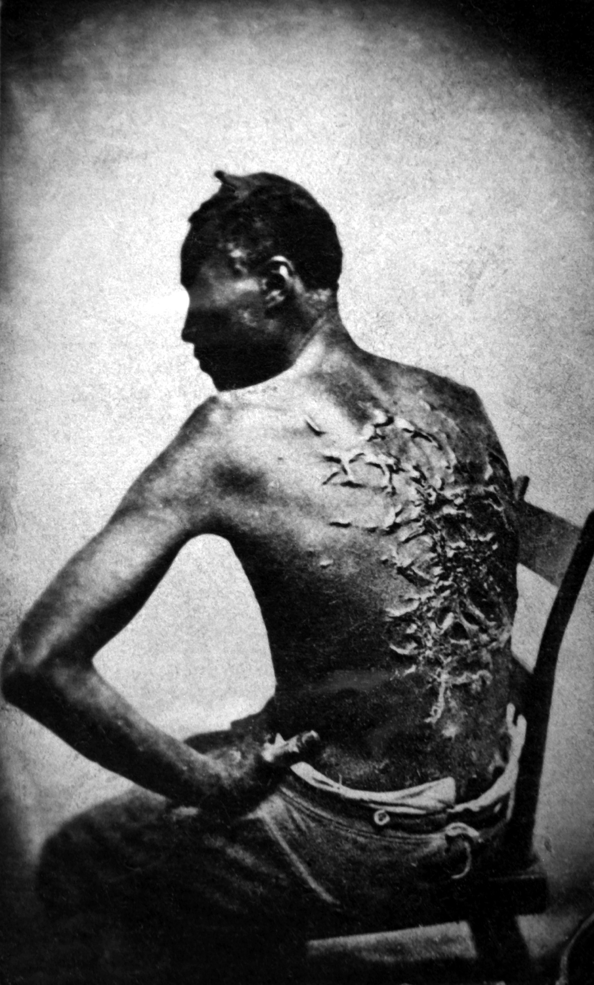

Slide 11
Conflicting Depictions of Slavery
https://www.youtube.com/watch?v=WX9qZVldxHU

