Slide 1
Transcendentalism and its Impact

Slide 2
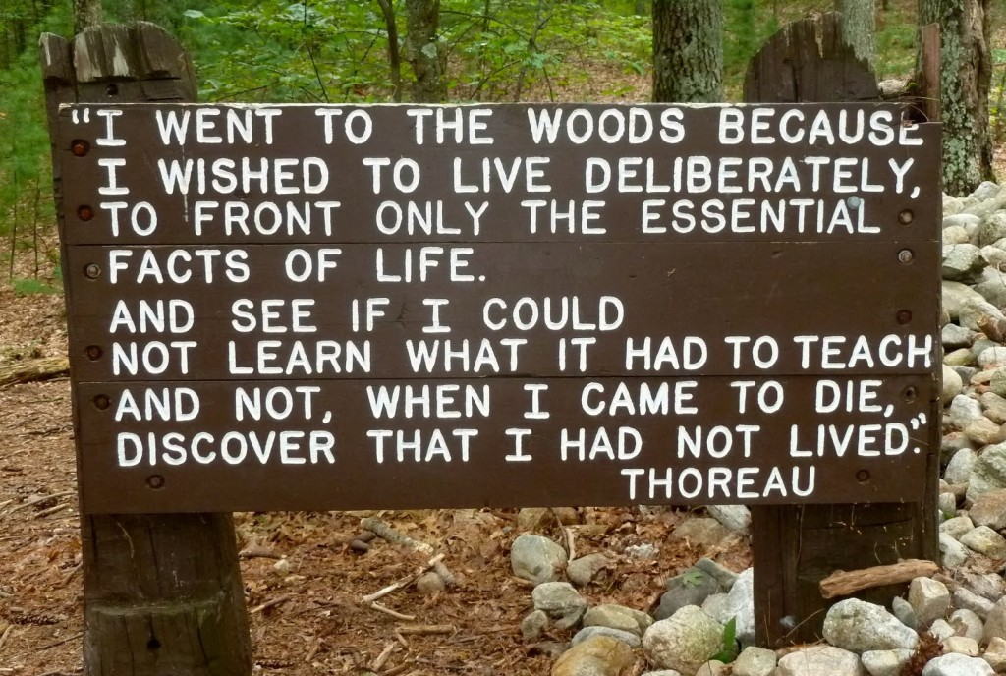
What is it?
Rapid economic growth and geographical expansion weakened traditional institutions.
Ralph Waldo Emerson was the first to push the idea of individual liberation
Embraced passion and deeper insight into existence
People were trapped by inherited customs and institutions. They needed to shed these values rediscover original relationship with nature
This was the first hippie movement

Slide 3
Transcendentalism and America
Became popular with the middle class who let family farms to make it on their own in the urban world.
They worried that the new market society was moving Americans away from their spiritual lives (however, this was NOT a religion)
Eventually looked at reforming society through education and abolition of slavery.

Slide 4
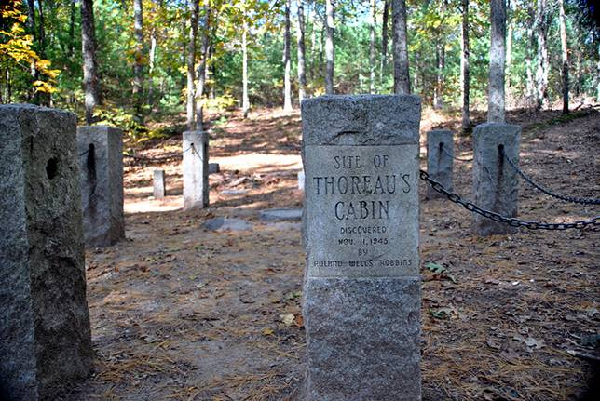
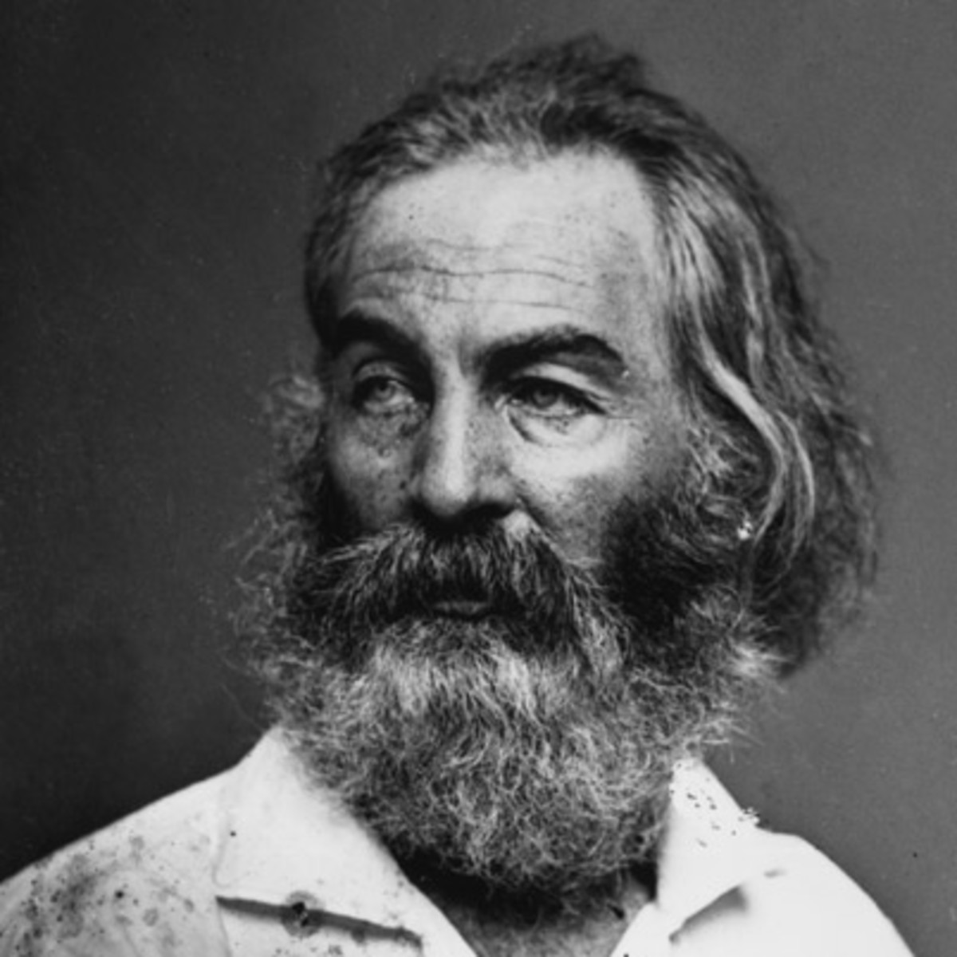
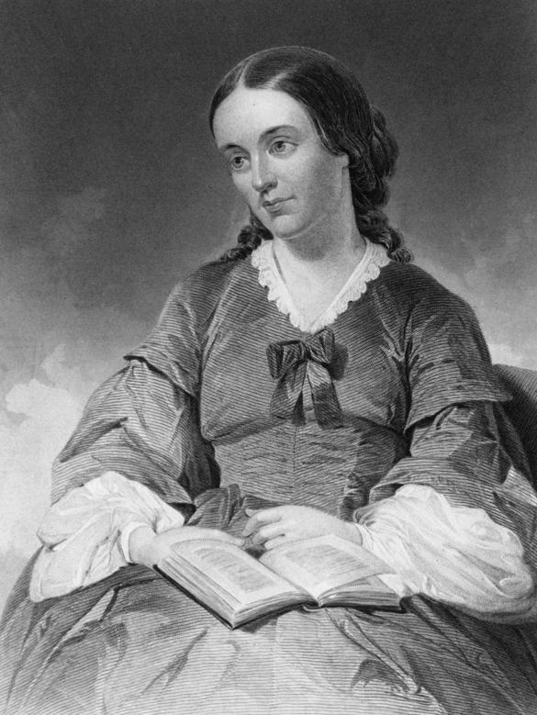
Emerson’s Impact
Henry David Thoreau: looked for inspiration in the natural world, moved to Walden Pond for two years. Advocated for individuality and nonconformity to social norms and unjust laws.
Margret Fuller: advocated for women deserving psychological and social independence
Walt Whitman: the sacred power of the collective and democracy

Slide 5
How might this impact thoughts on slavery?

Slide 6
How might this impact thoughts about women’s rights?

Slide 7
Do we see this today? Where?

Slide 11
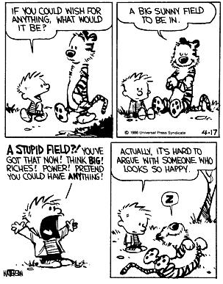

Slide 12
You must complete ALL THREE stations
Only need to write one group copy
Need a list of ten songs and people, explain the reasoning behind FOUR of each.
Thoreau-People
Emerson-Songs
Five movies that are inspired by Transcendentalism

